Slide 1

WGBS Data Analysis – Visualizations
Shuya Zhang & Aryan Gupta
13.05.20 Warwick

Slide 2
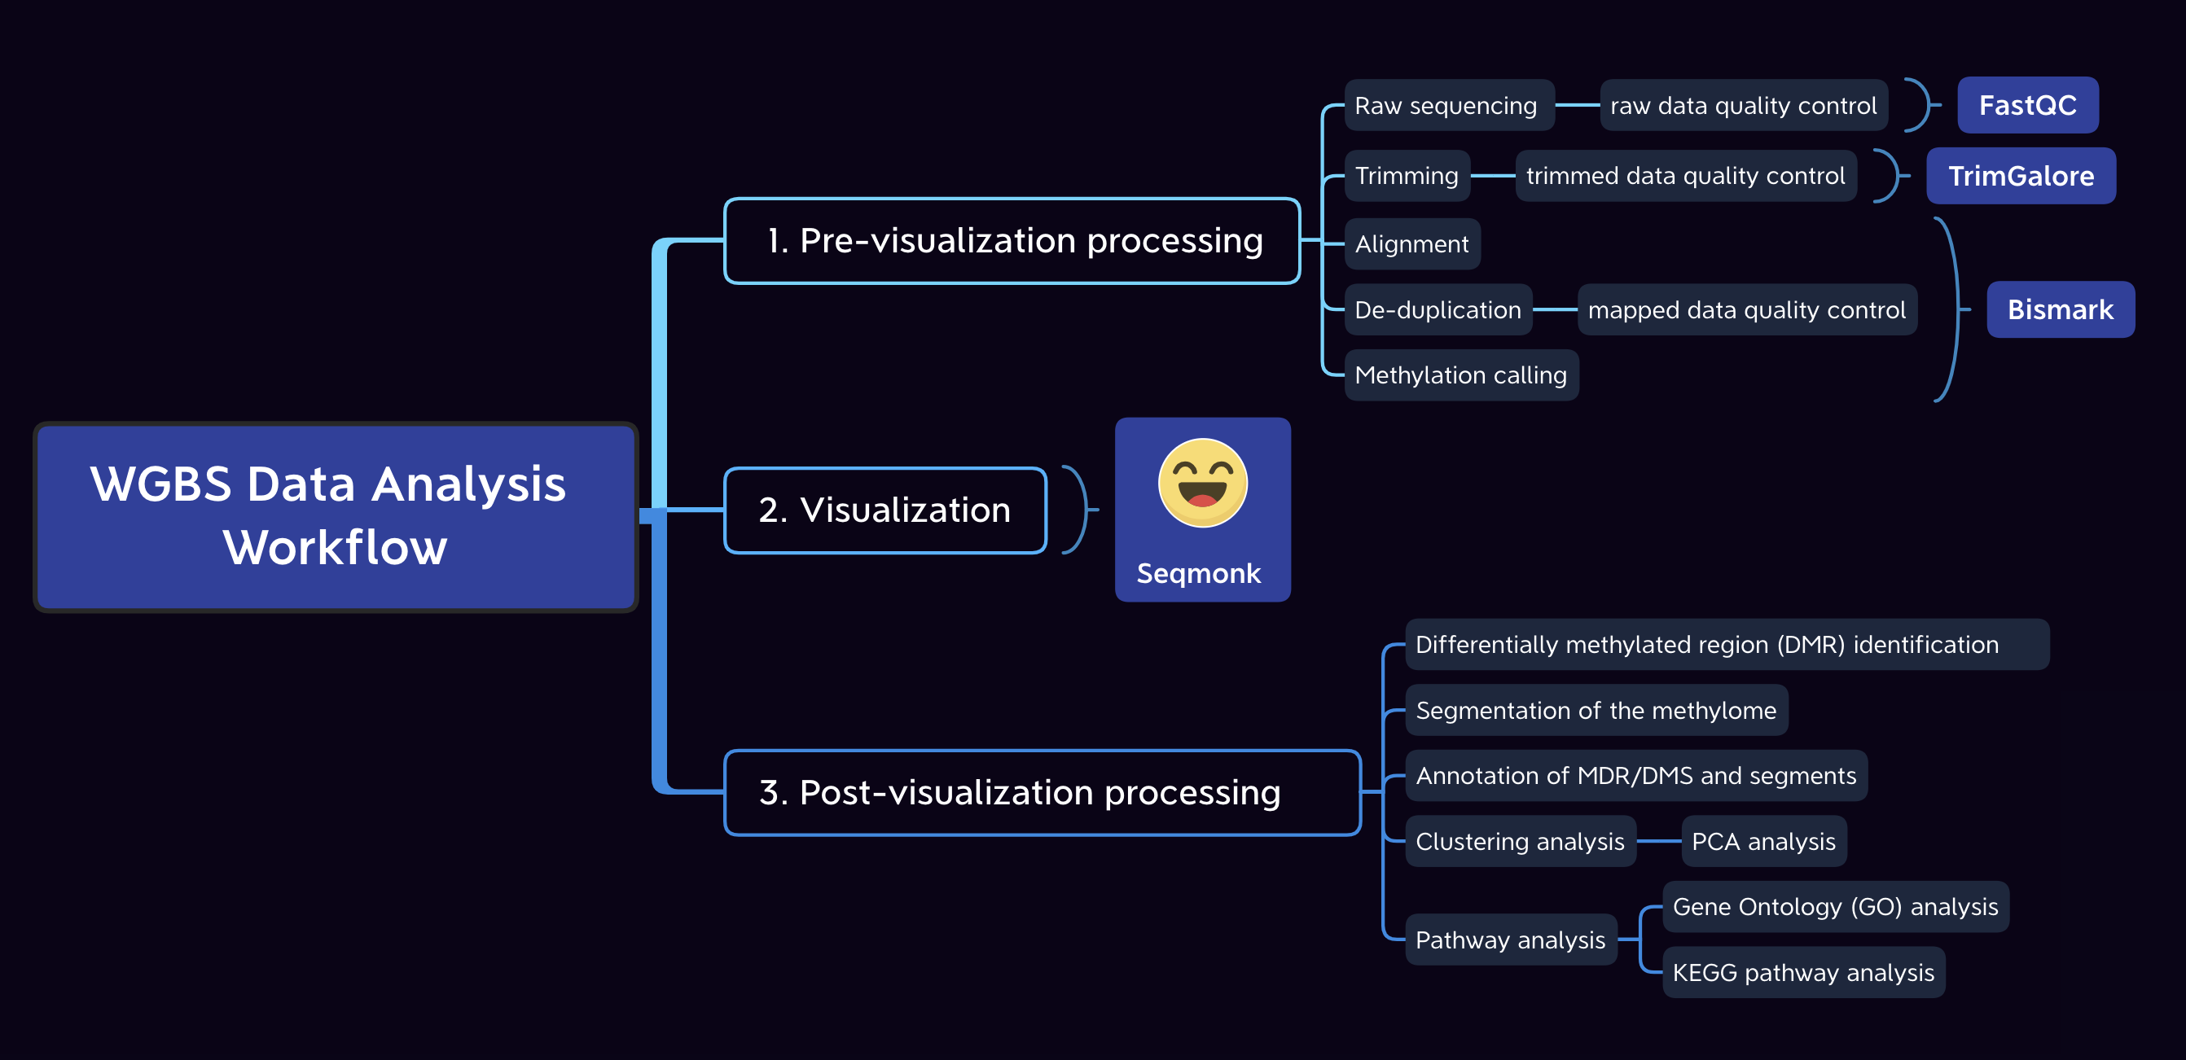
WGBS data analysis workflow
Notes:
首先：提出科学问题 （现有的问题，能想到有三个）
其次：分析类型，根据我们的科学问题确定数据挖掘的方向和深度 （太细的分析流程不用说，只要说分析类型就好）
最后：解决问题
自己不一张图
可视化只是为了上我们更好的找出差异，但是这不是最终的分析，所有的分析都需要跟后期功能上钩

Slide 3
Intermediate point: VISUALIZATION
The results before visualization are general and superficial.
Visualization can guide us with data mining.
Visualize your quantitative values to understand the sort of global pattern of methylation is in your sample and to be able to compare between samples

Slide 4

PART 1 pre-visualization
A quick overview
Conclusions

Slide 5
A few things to do before starting post-visualization
Summarizing pre-visualization data ----- Independent work
Formatting scientific questions -----Group work
Selecting appropriate methods for post-visualization analysis ---- unfined

Slide 6
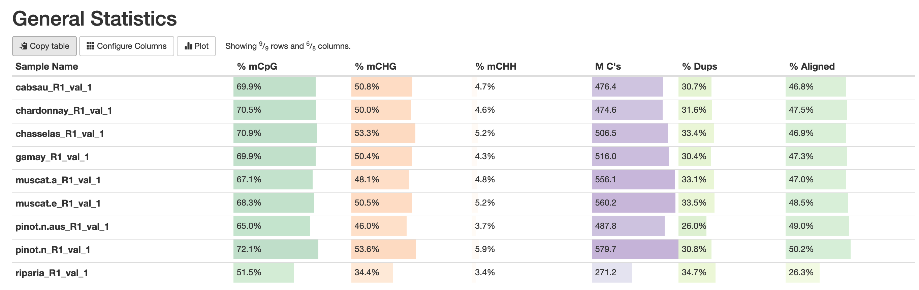
A quick overview of pre-visualization processing

Slide 7
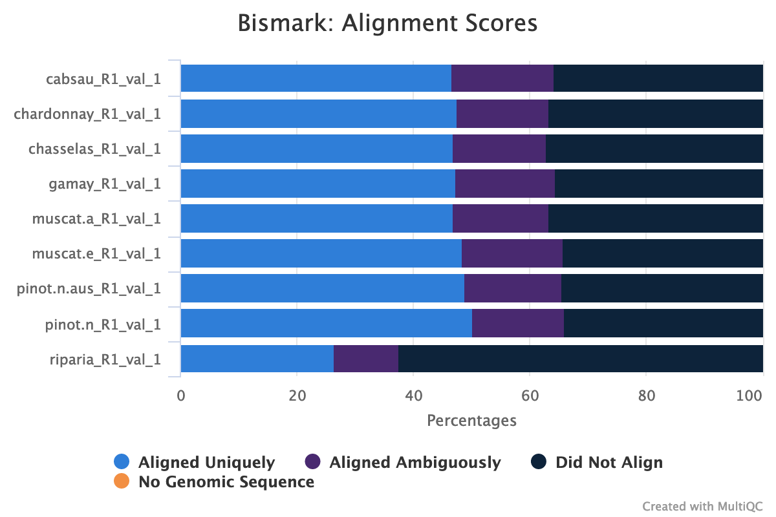
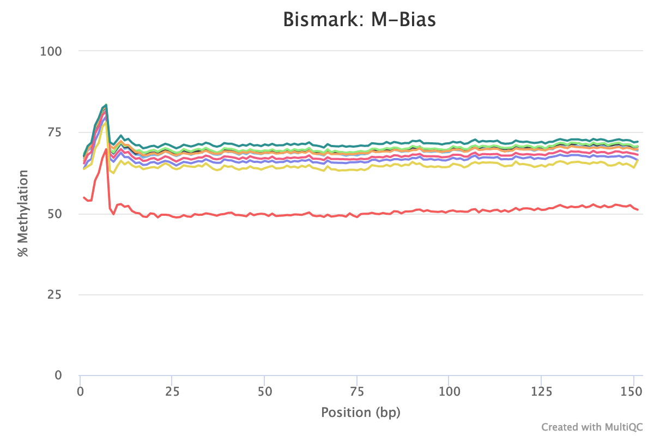
A quick overview of pre-visualization processing

Slide 8
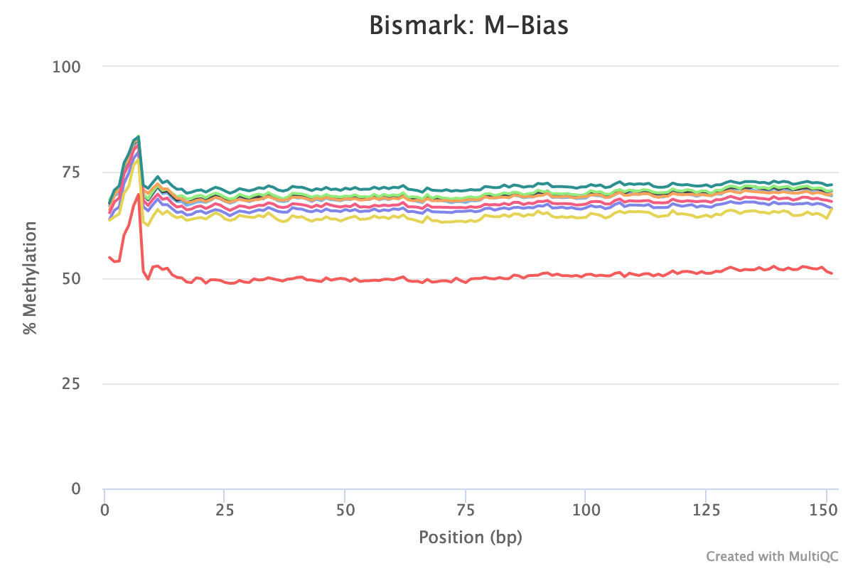
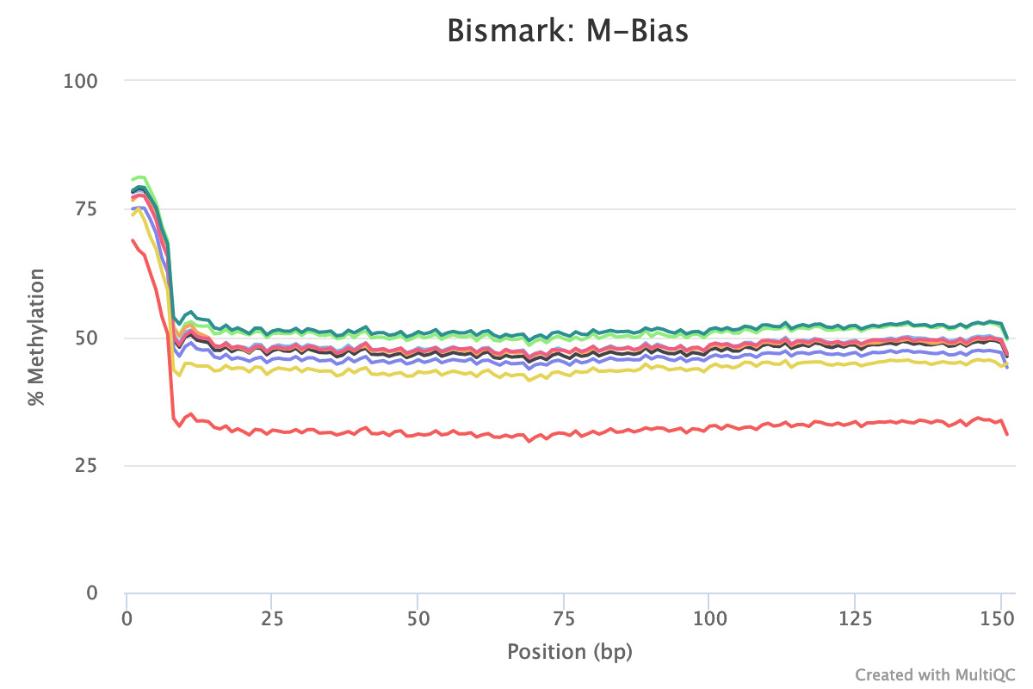
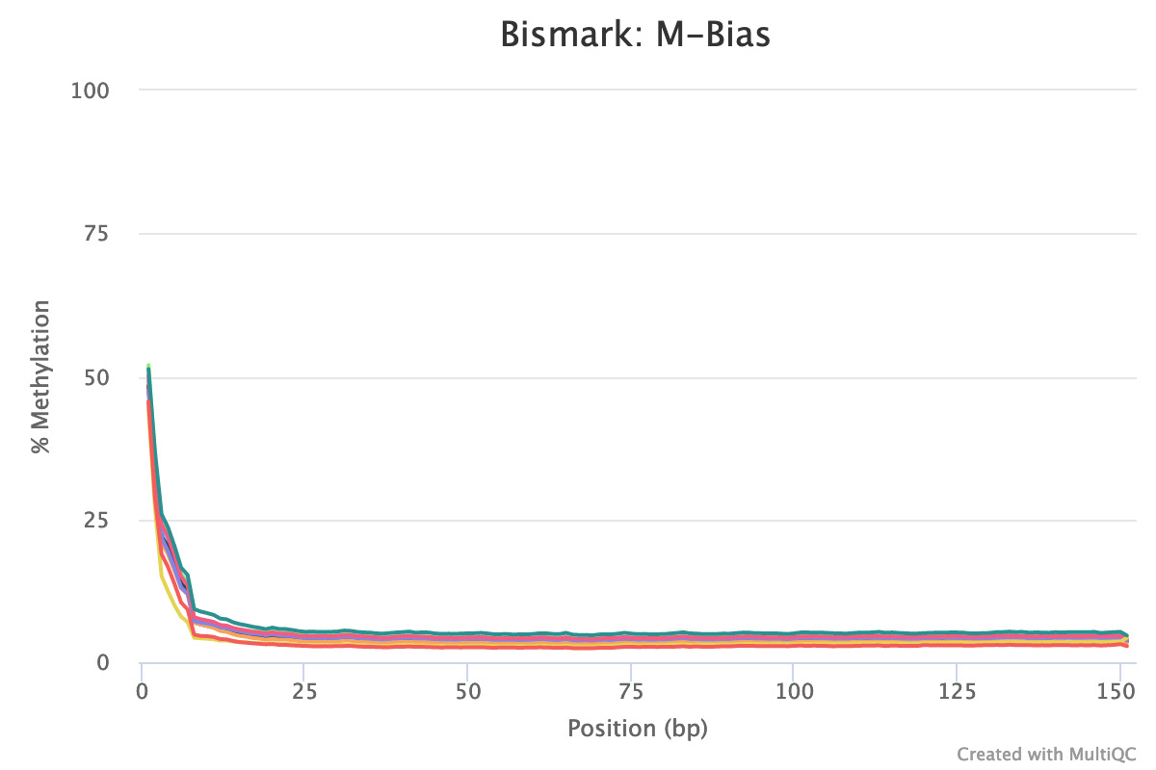
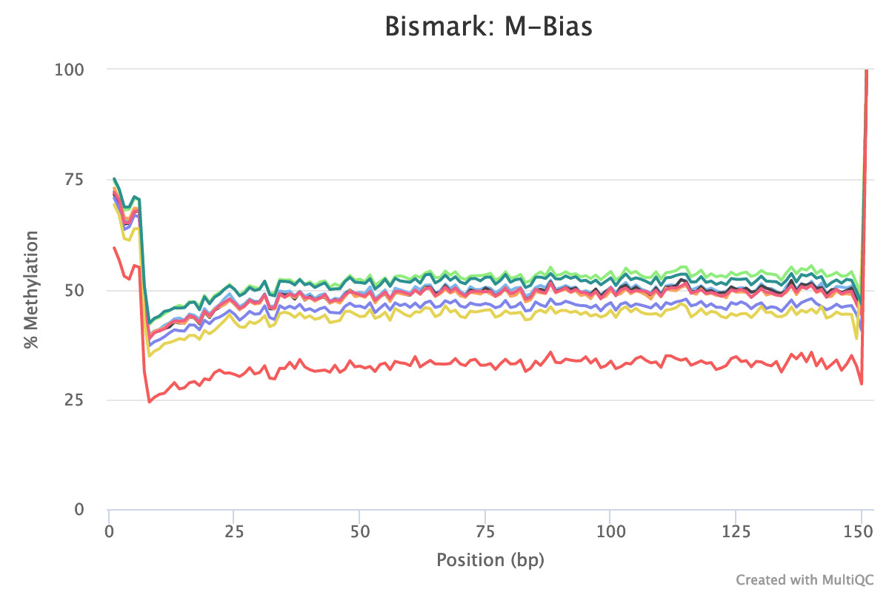
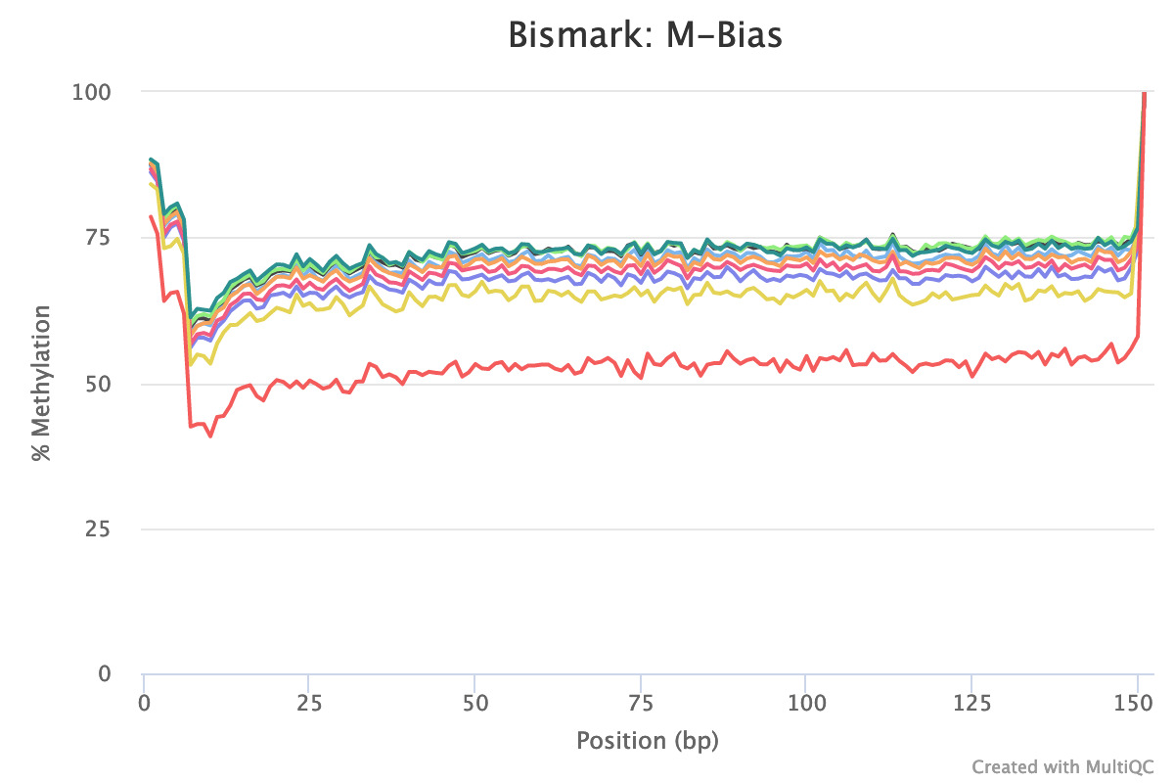
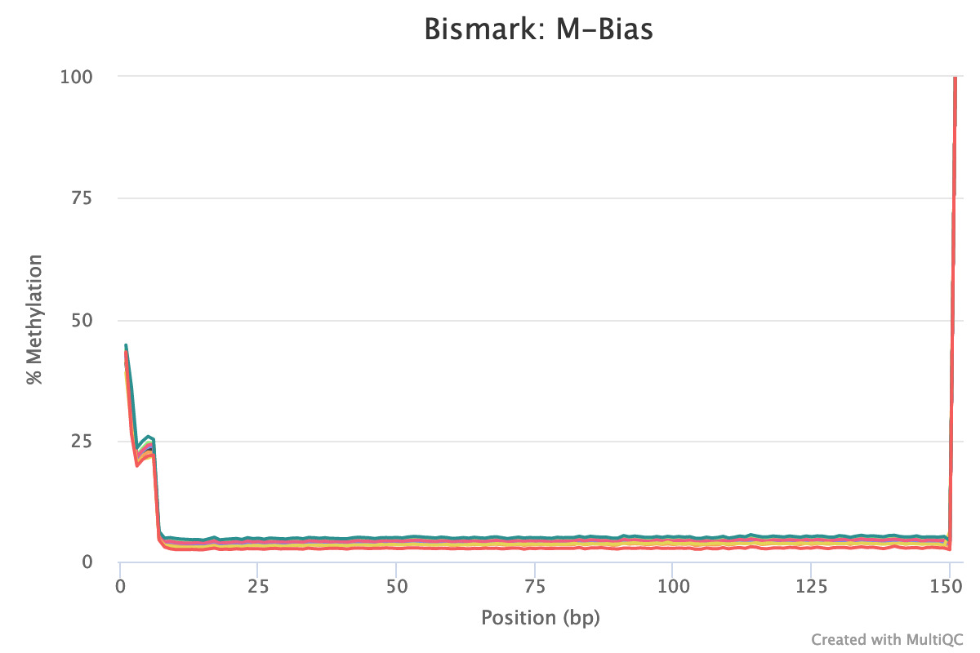
M-Bias this plot shows the average percentage methylation and coverage across reads

Slide 9
Conclusions
Raw data quality is good.
Unique reads mapping efficiency is about 50%.
Cytosine Methylation are in CpG, CHG context, methylation ratios in CpG are 70 %, and 50% in CHG, while 5% in CHH.
Overall, similar general trends in our data, such as mapping efficiency, methylation ratio, and methylation context.

Slide 10
PART 2 Visualzation
Step 1. Quantitation
Step 2. Visualization
Step 3. Summarizing methylation

Slide 11
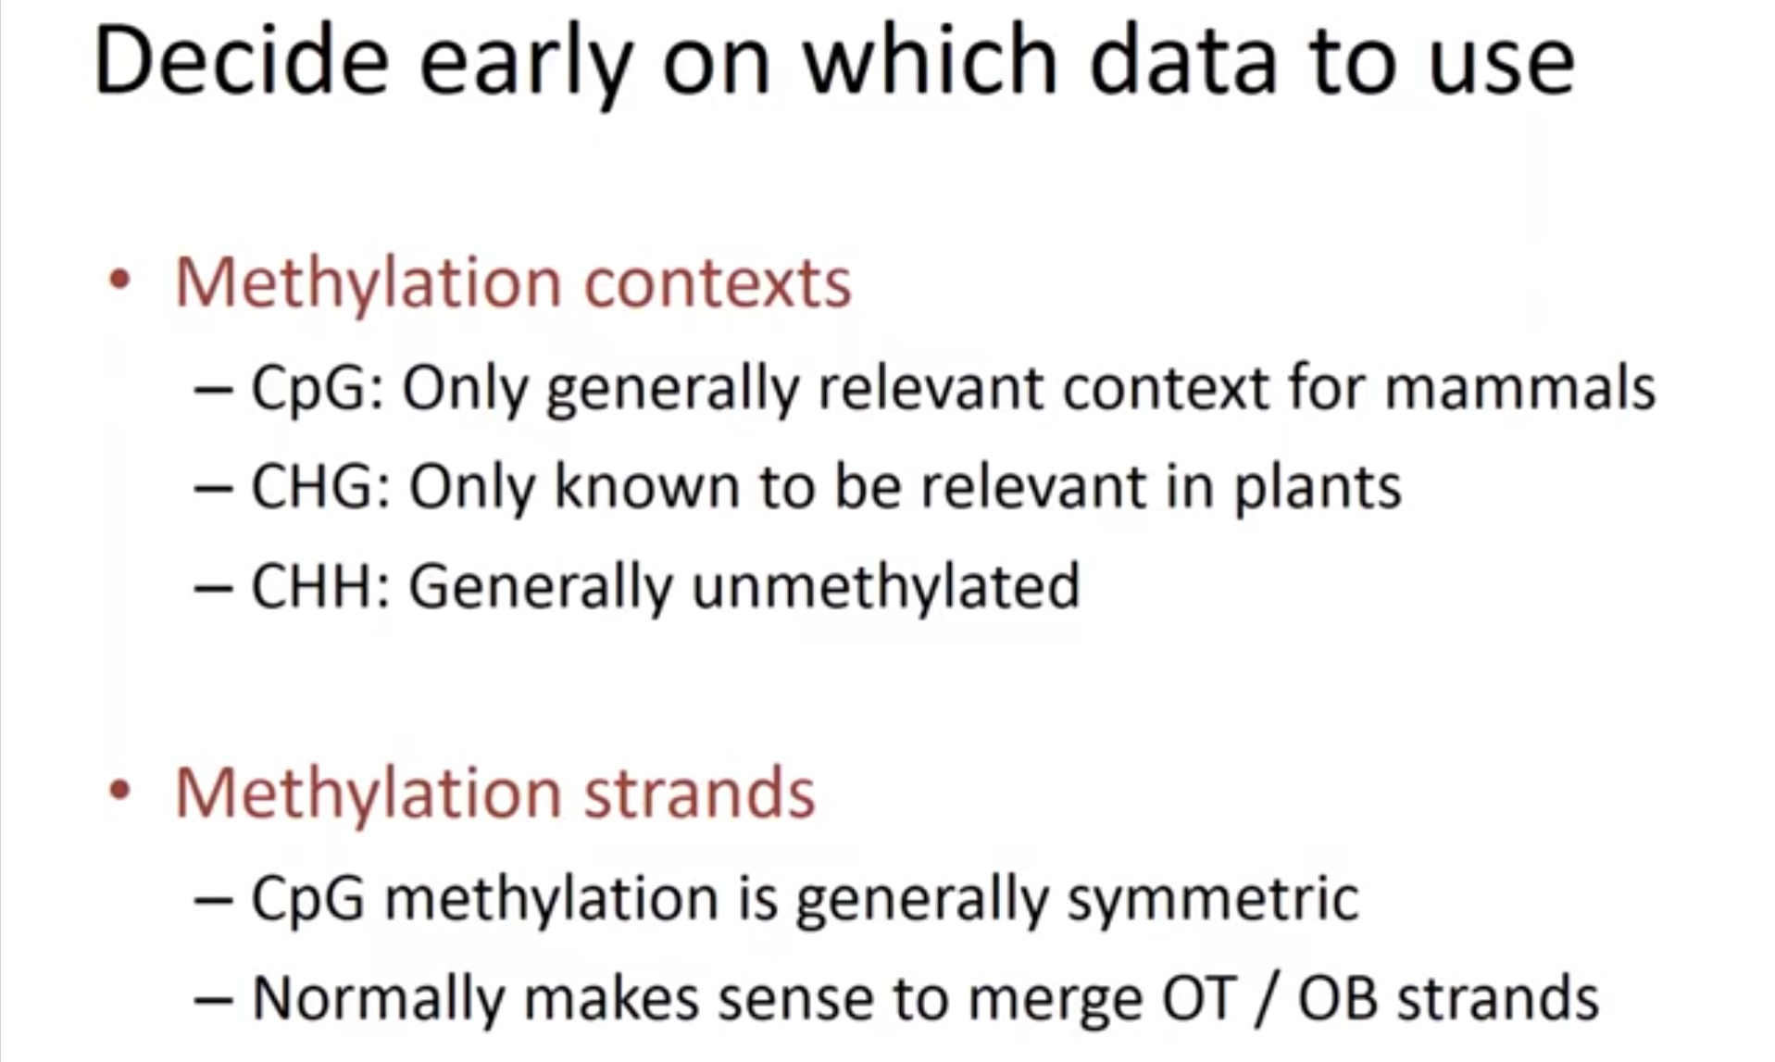
Assumption

Slide 12
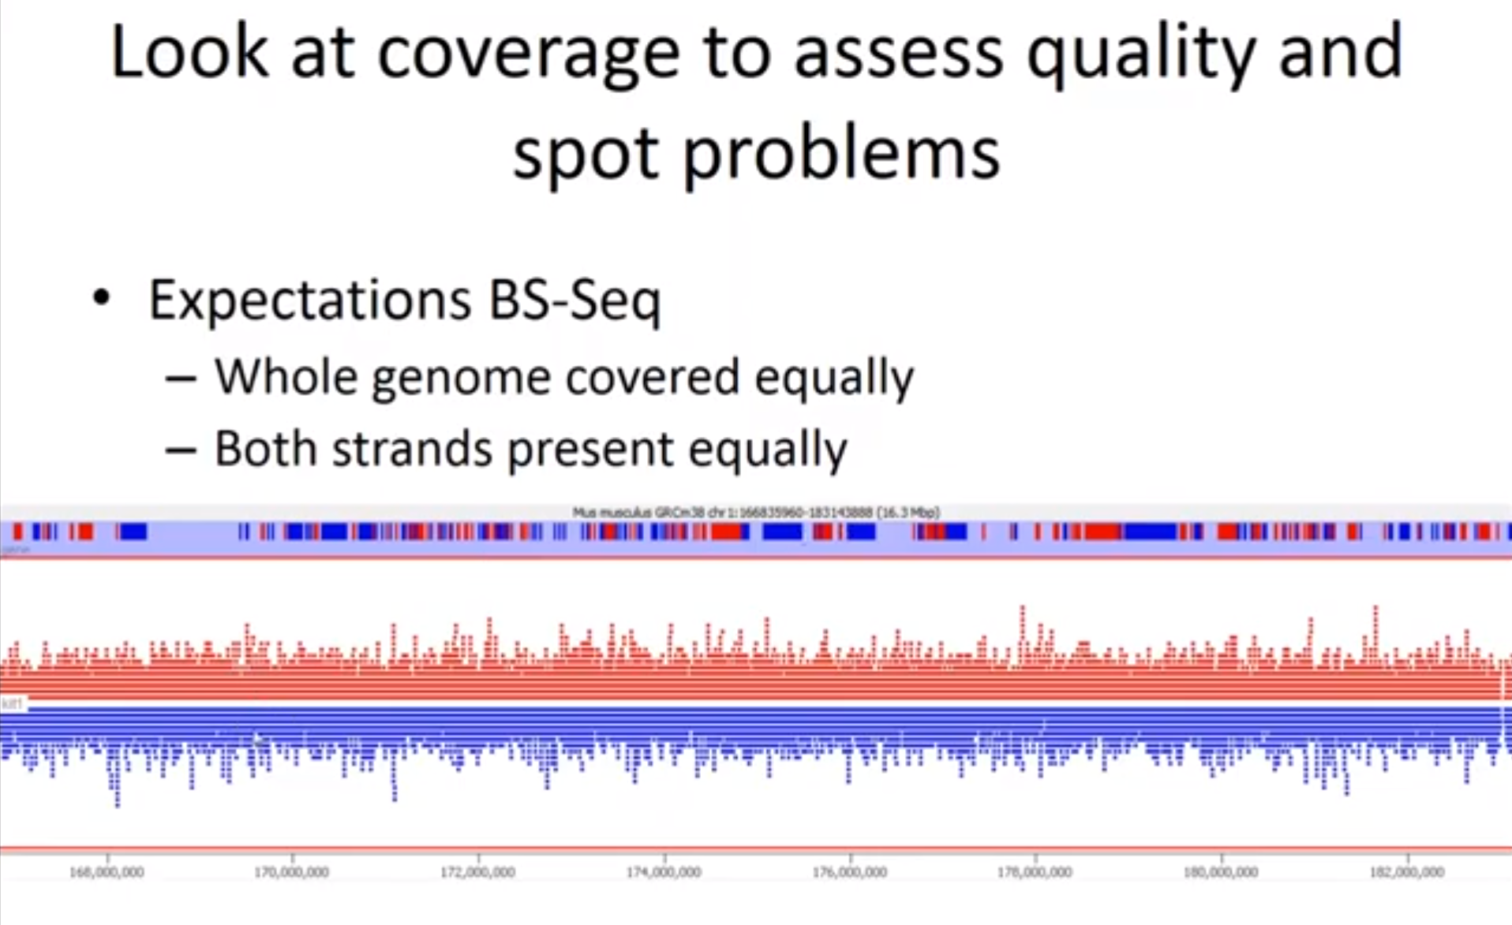
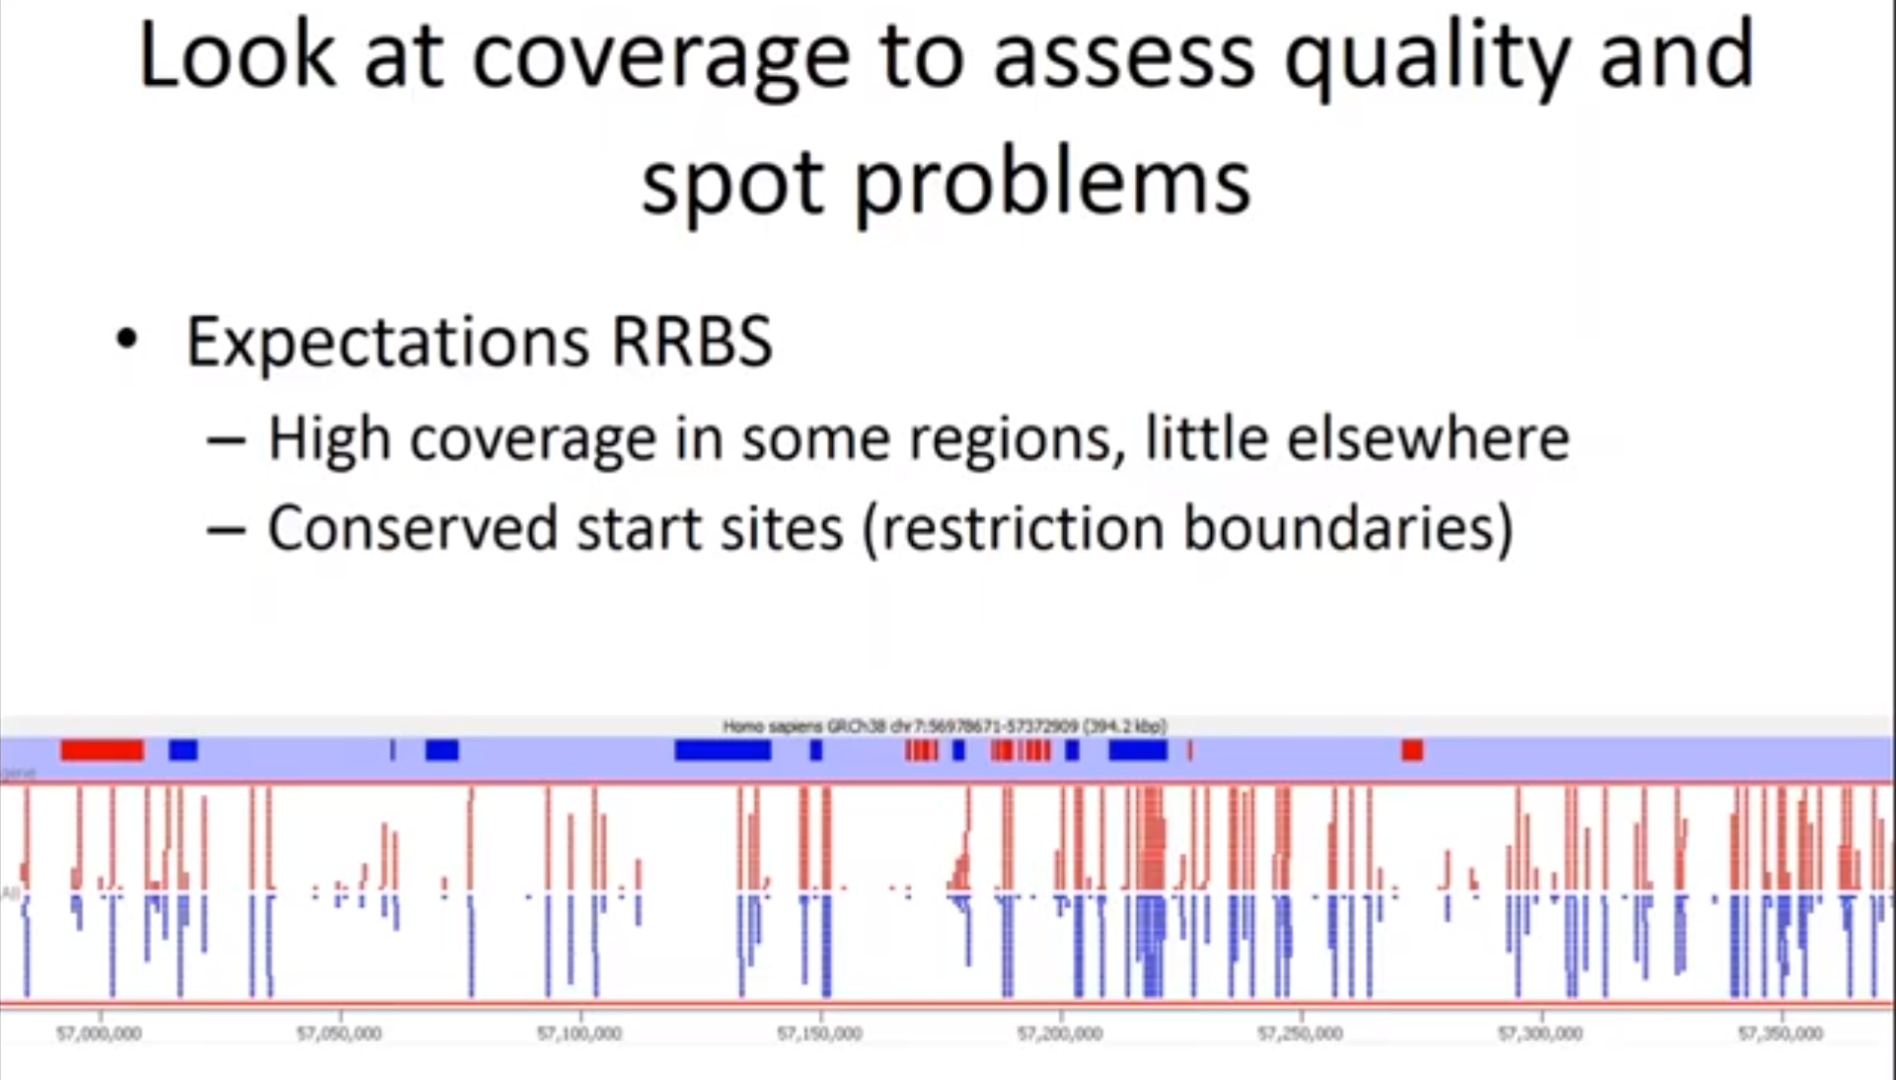

Slide 13
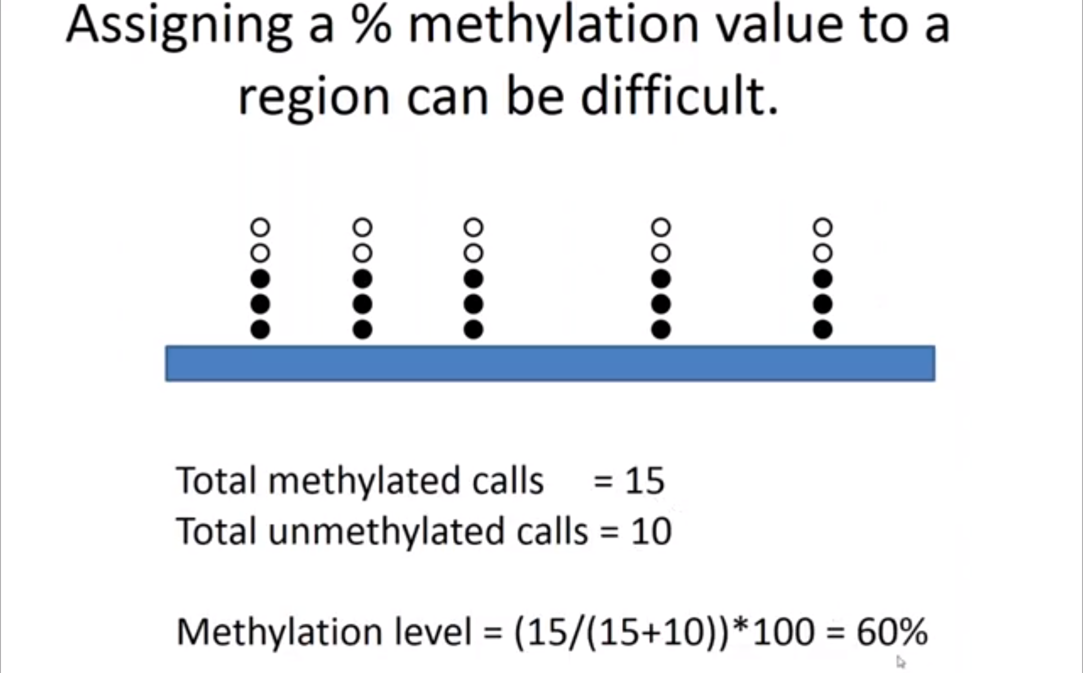
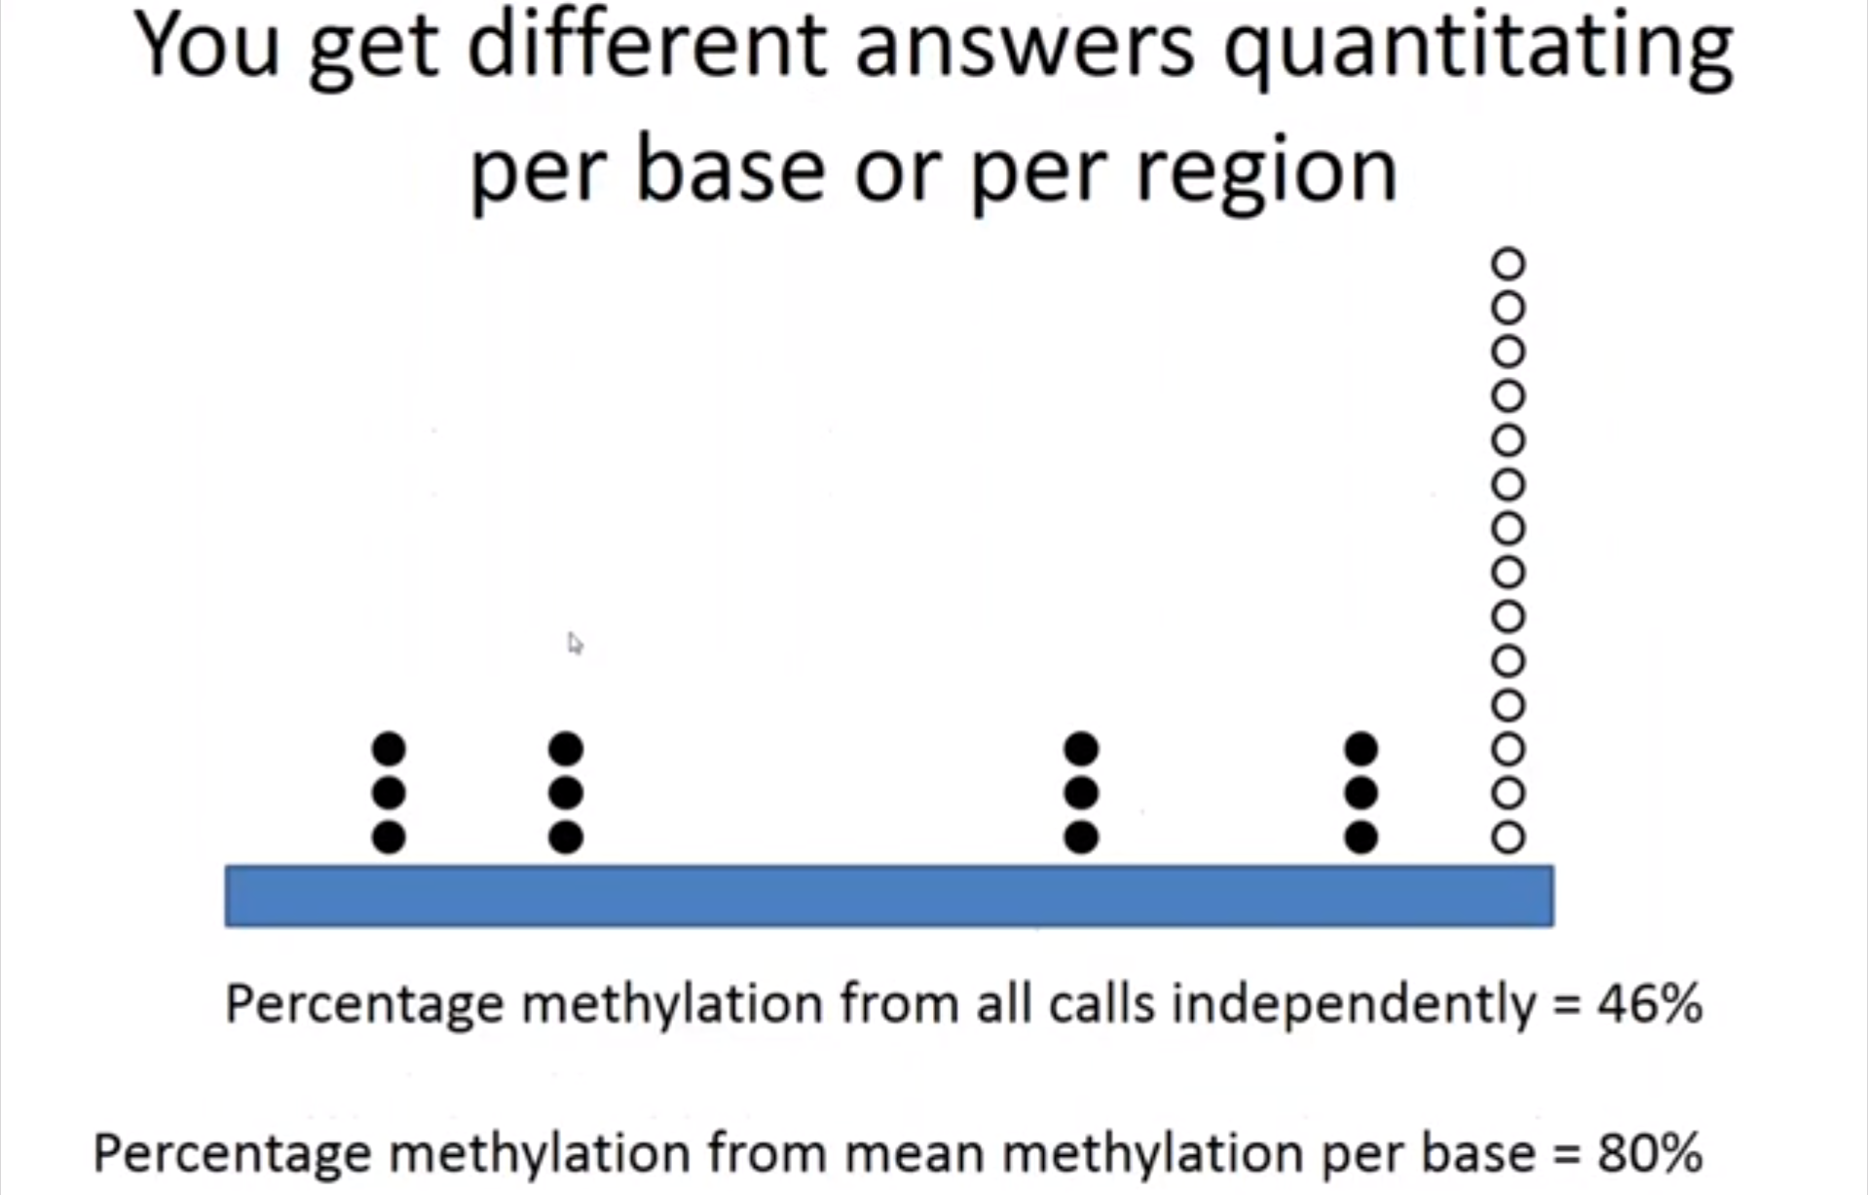
Step 1 - Quantitation
1st step to quantitate your data - %methylation
No. of methylated calls for a given region / Total No. of calls [& unmethylated]
Initially have multiple indv. Methylation calls – Collapse to a single numerical value
Ideally –
HOWEVER…

Slide 14
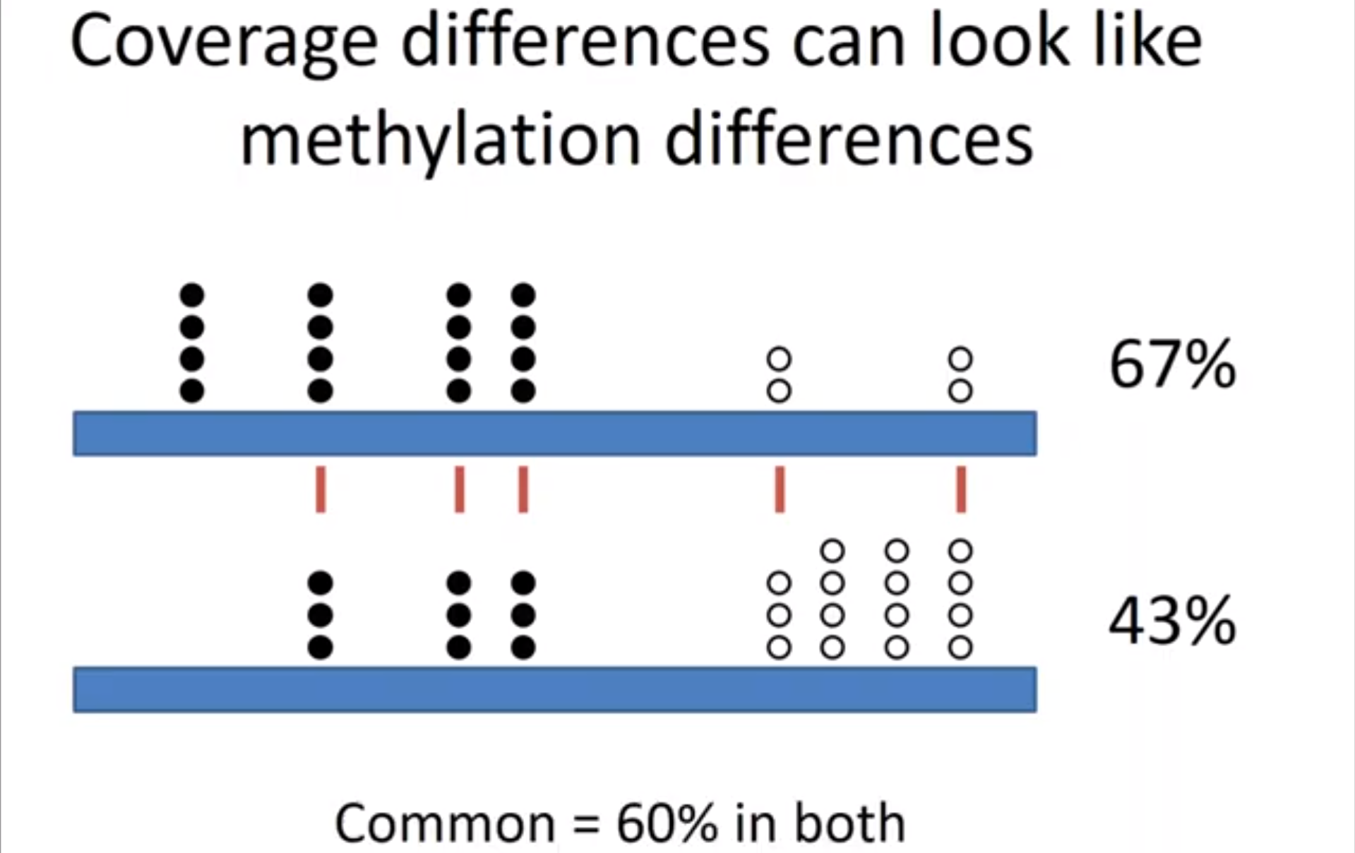
Why do we care ?
When looking for differential methylation - you can miss-infer the differences in coverage as they appear as differences in methylation
Coverage diff. ⇏ Methylation diff.

Slide 15
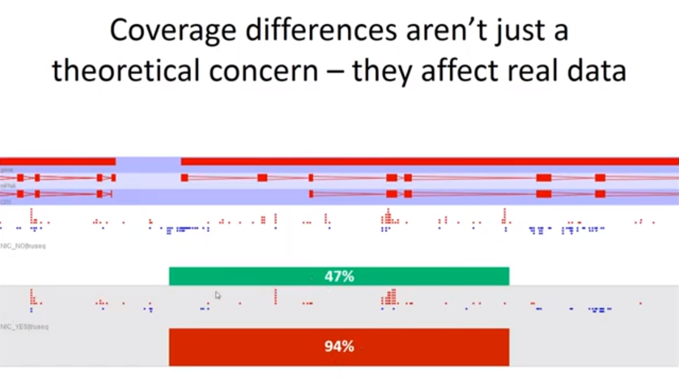
Looking at Methylation Calls …
M - Red
Changes the whole game
UnM - Blue

Slide 16
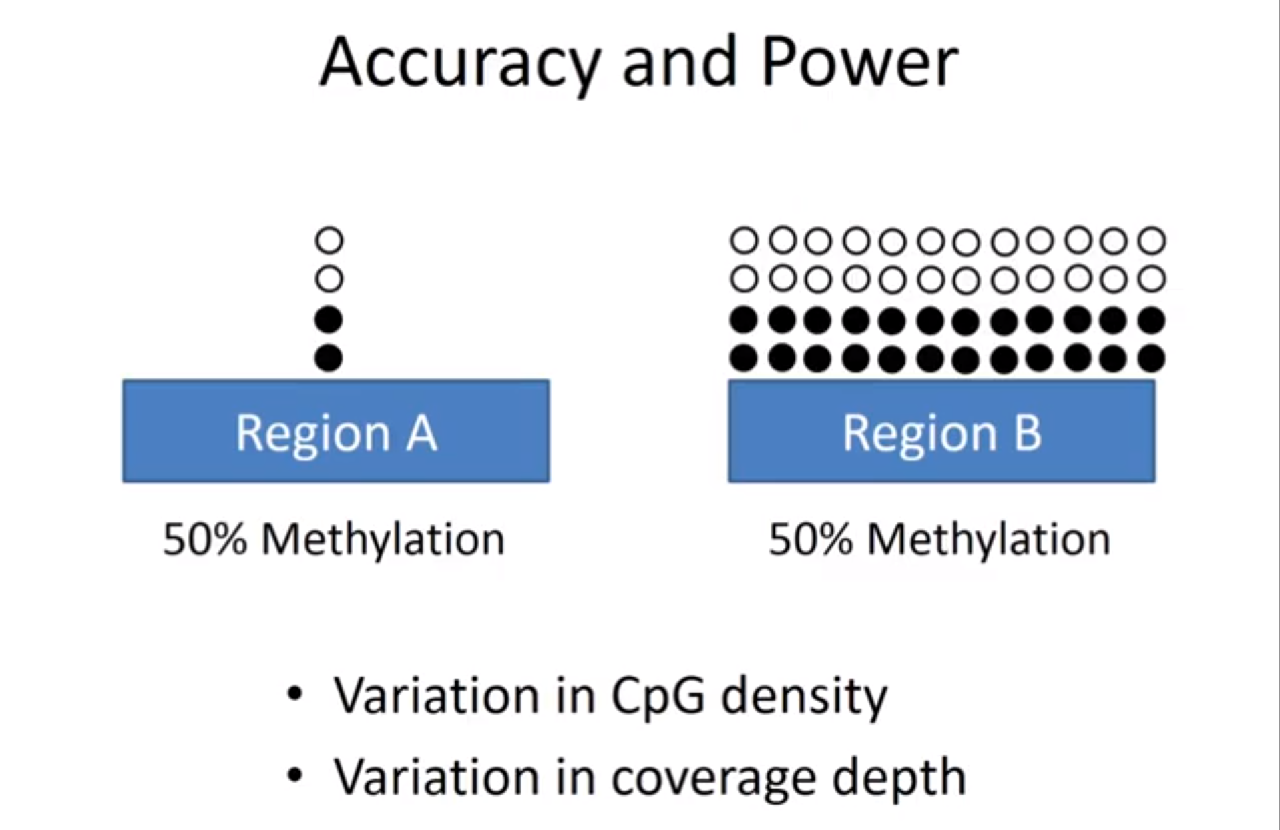

Appear same – but “even” small change in region A can alter %
Small data set, inaccurate
Large, accurate & Stable
Variation causes for same size data set
some kind of enrichment and there was more data over the region A than region B

Slide 17
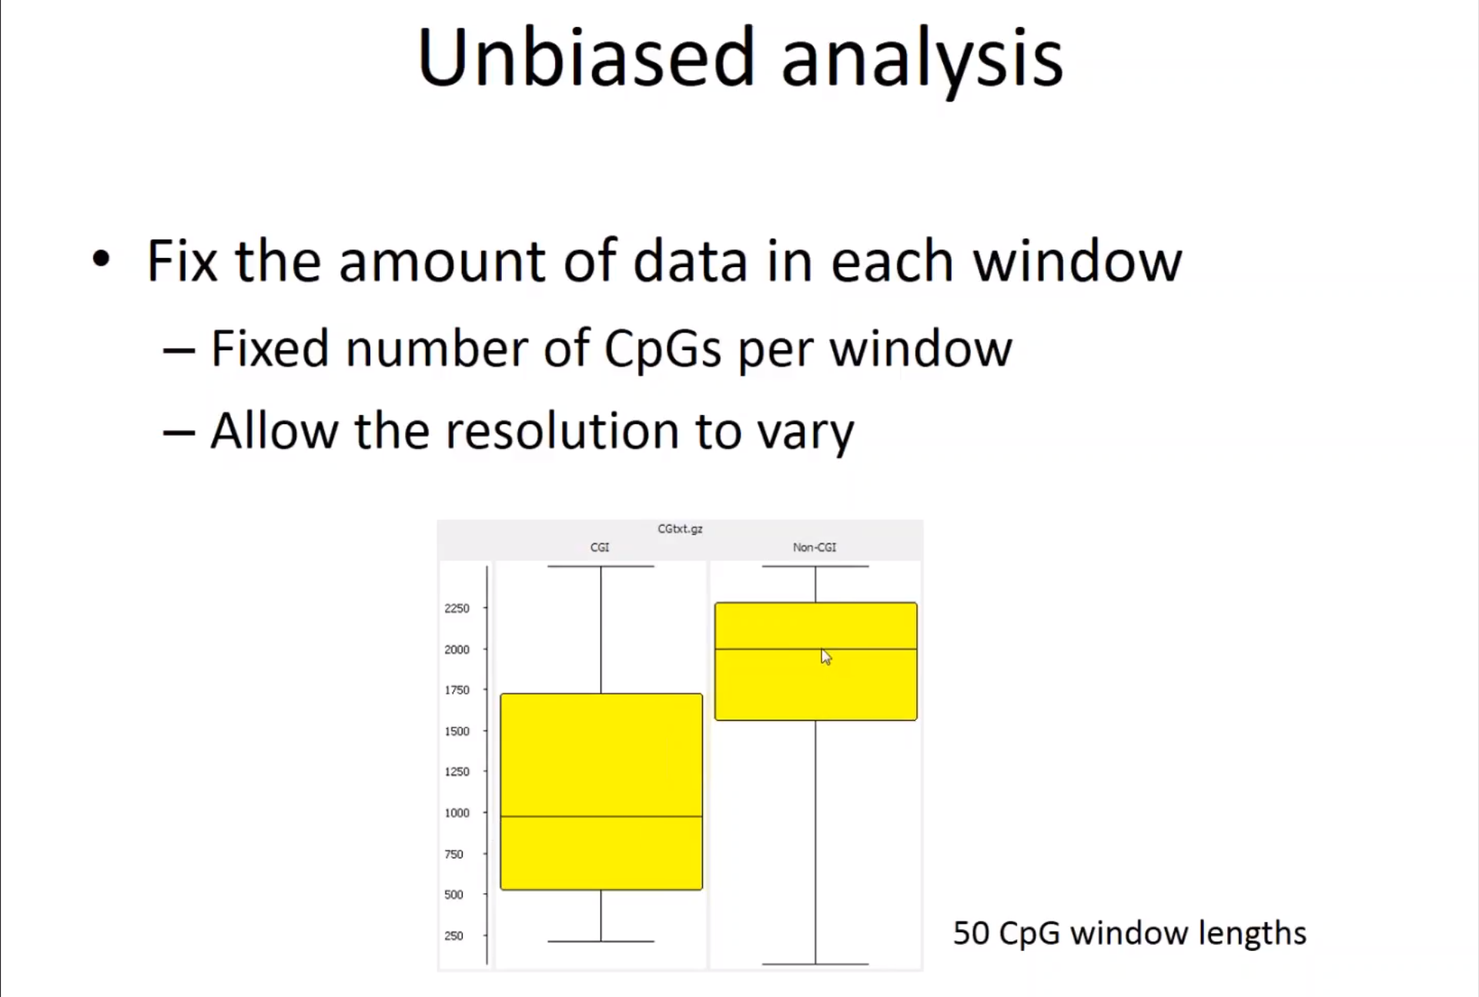
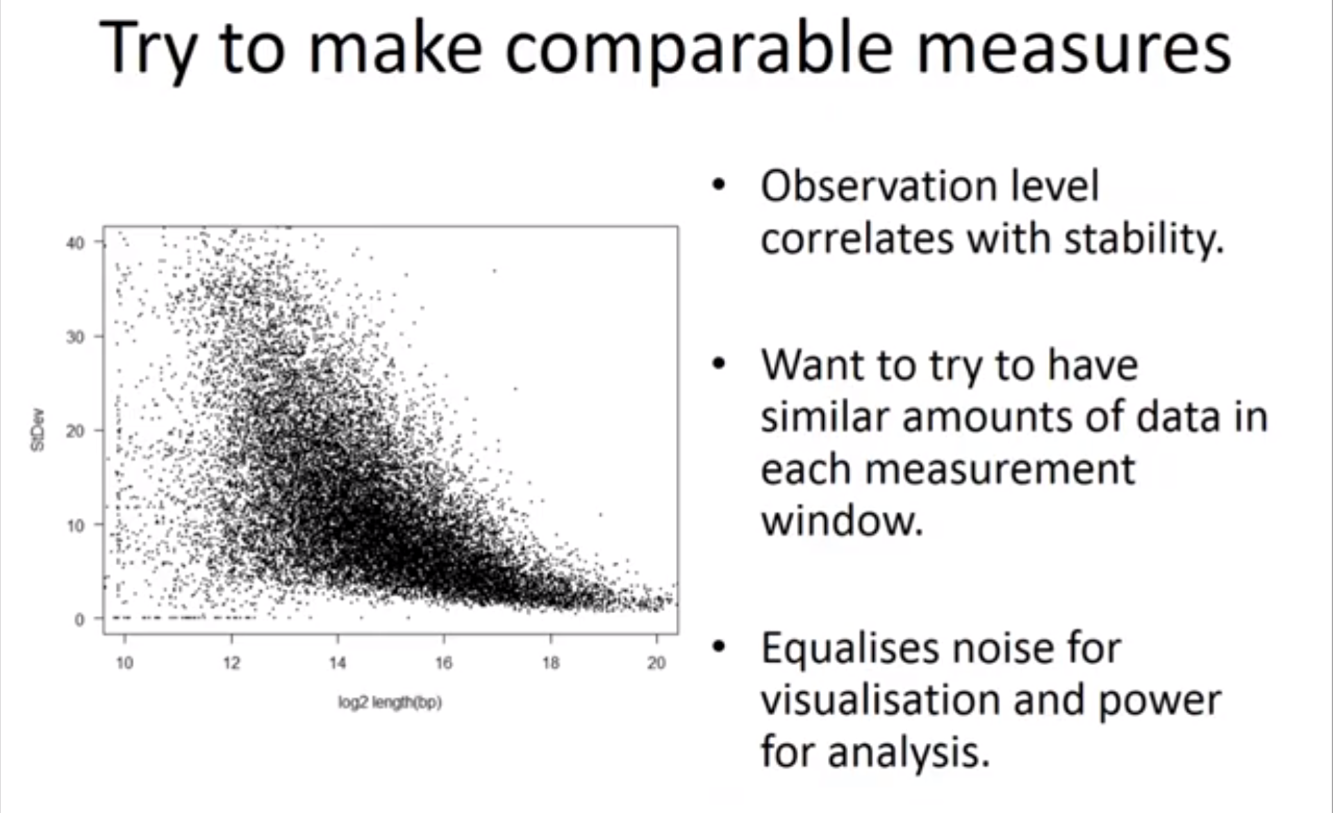
What does this mean for us?
Avoid bias
Analysis in a way - construct measurement windows that as much as possible have the same amount of data in each window
Notice: ↑ Length of region ⇒ ↓ Std. Dev. [a.k.a error]

Slide 18
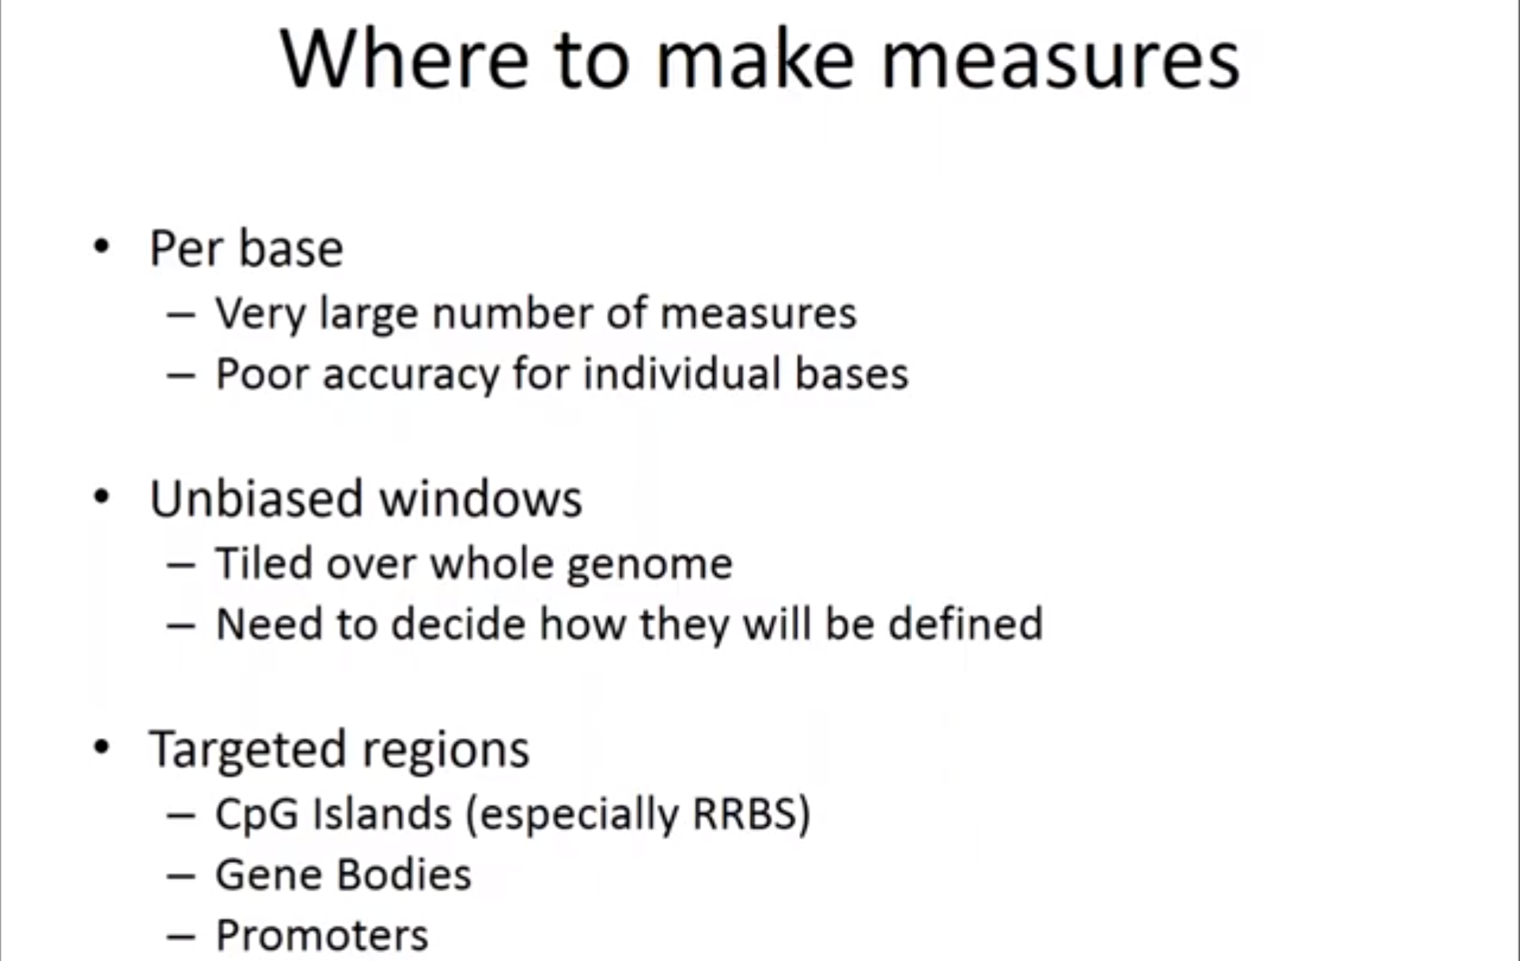
Step 2 - Visualization [SeqMonk]
SeqMonk Functions:
load your coverage files in see all the views
sorts of views quantitate your data
do the statistical comparison
{works end to end}
Why Visualize??
visualize your quantitative values to understand the sort of global pattern of
methylation is in your sample and to be able to compare between samples.

Slide 19
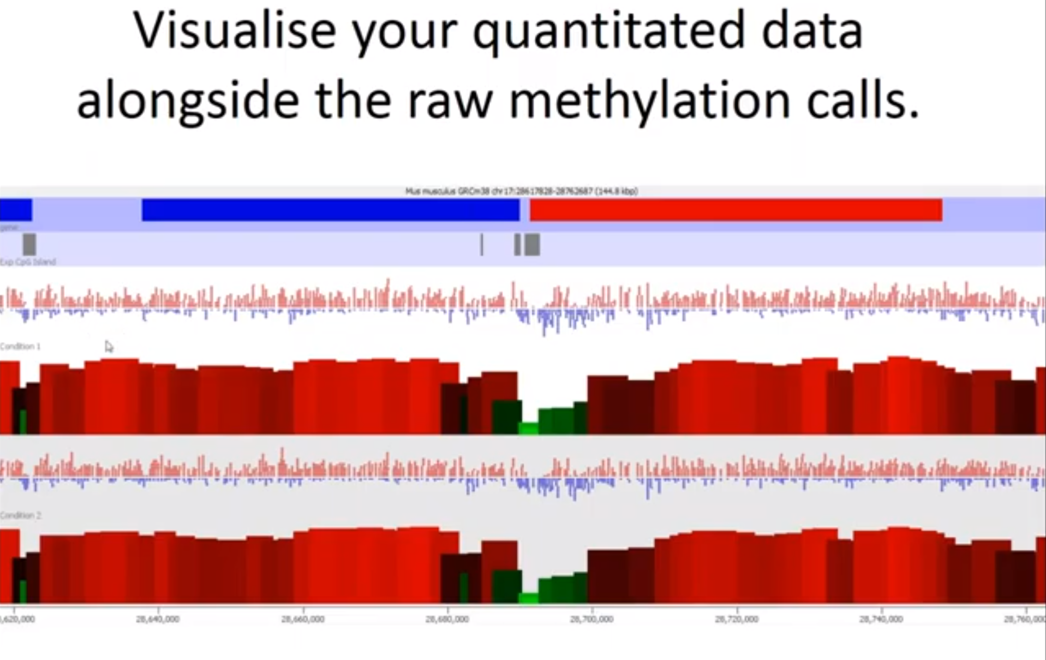
Genomic context Side by side Comparison of Raw data Vs. Quantitative data
General Correspondence should be observed
CpG
Methylation%

Slide 20
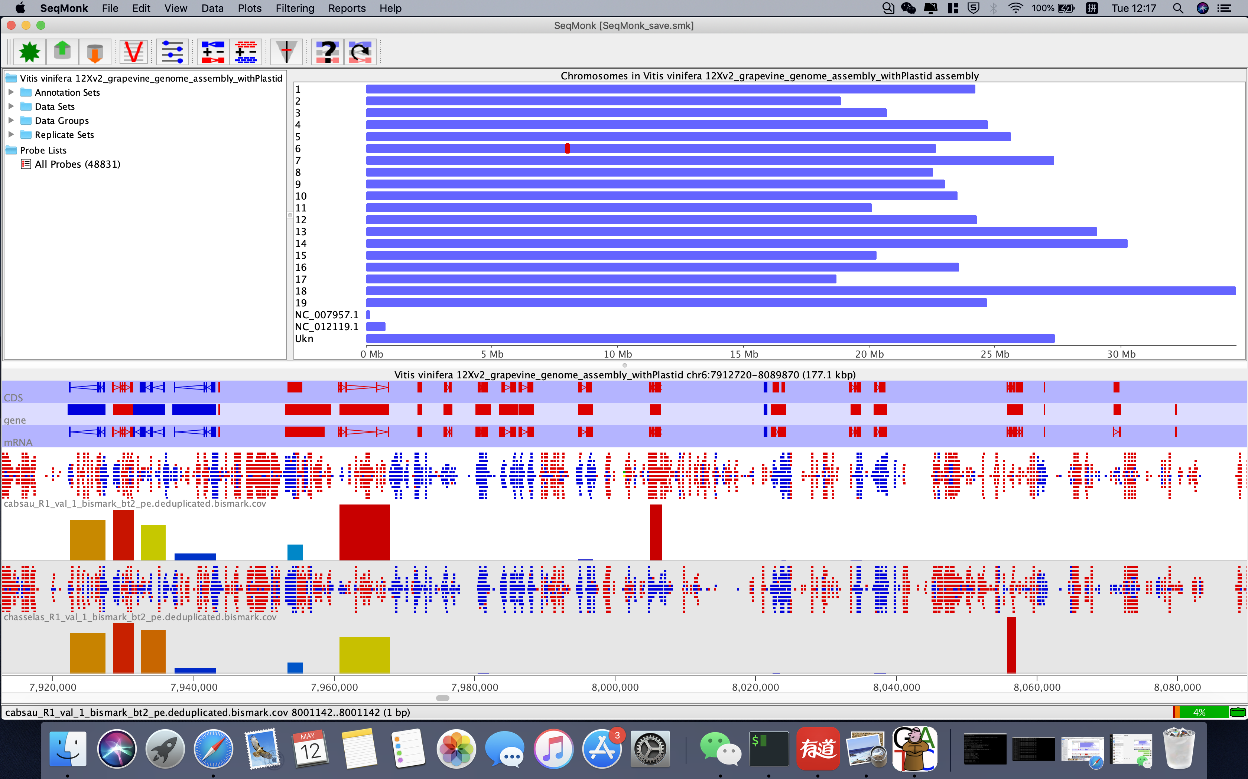

Slide 21
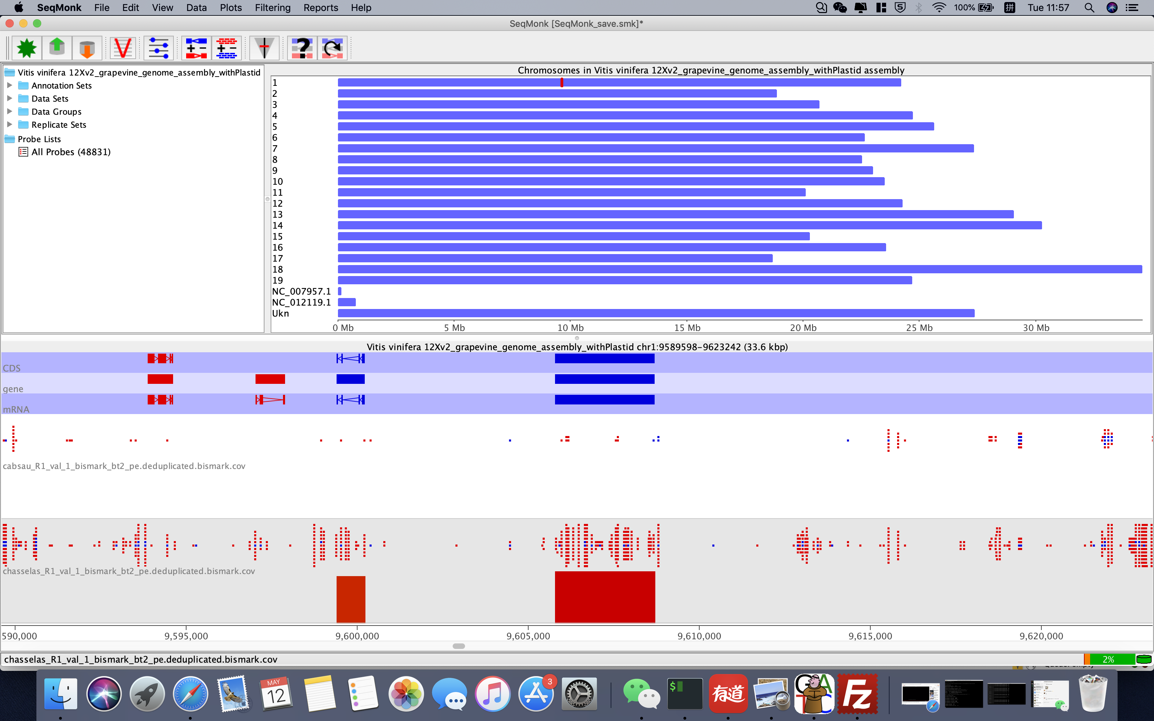

Slide 22
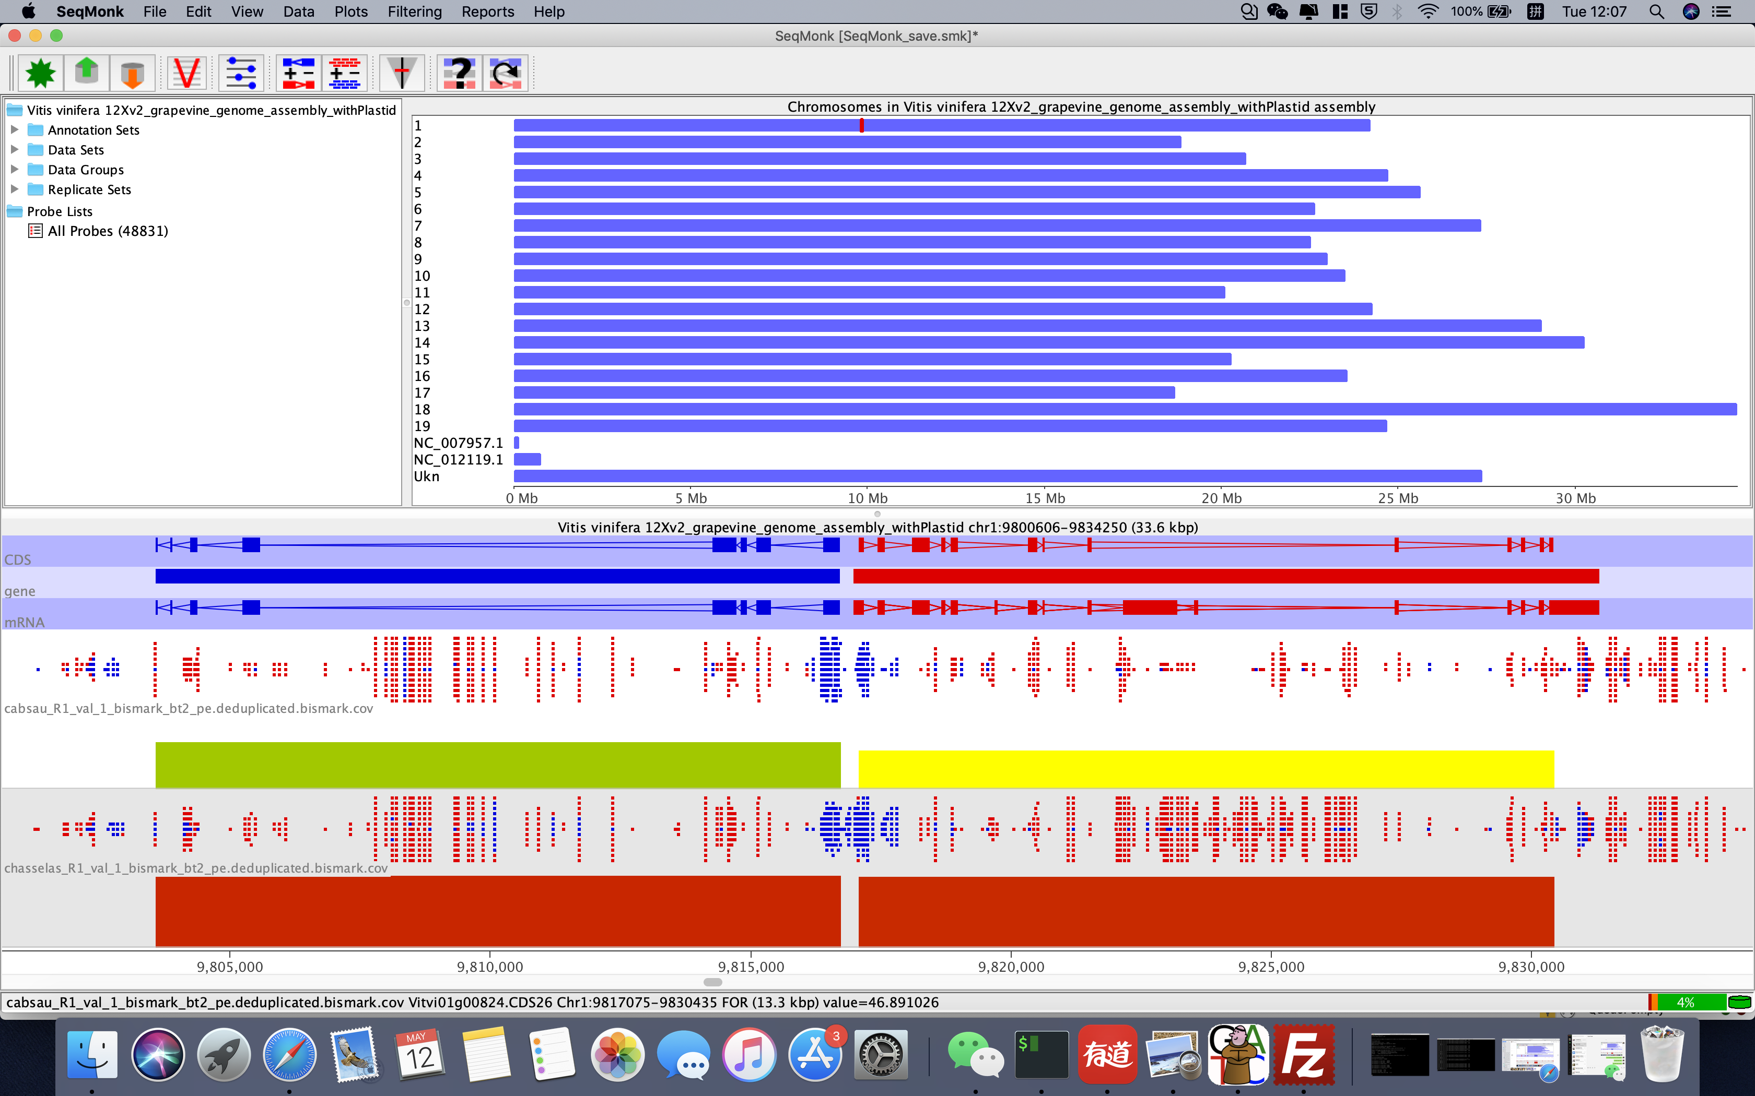
Notes:
查找蛋白质功能
chromosome or scaffold 区别是什么
如何把gff 注释编号和蛋白质功能联系起来。
需要了解各个网站的数据类型，数据格式，作为一个生信的学生。 做一个数据格式总结经验。
id type: 可选值包括chromosome,nonchromosomal,seqlevel。
（1）chromosome就不用说了；
（2）nonchromosal中包含了暂时未能确定染色体的序列；
（3）seqlevel包括sequence scaffolds, chunks 或者clones三个层次。
‘scaffold’：通过短的测序reads拼接组装成更大的序列—-contigs（通常来自全基因组鸟枪测序，WGS），但是还不能组成到染色体的程度。通常还需要更多的测序，来消除gaps并确定顺序（tiling path）
‘chunk’:当contigs序列能被组装成大的实体时，有时候必须认为的将其打断为更小的实体，称之为’chunks’。这是由于注释管道的限制并且受存储序列和注释信息的MySQL数据库的记录限制。
‘clone’ ：通常这是最小的序列实体。它经常与一个BAC clone或者部分区域的序列是一样的。

Slide 23
Step 3 - summarizing methylation
Look Globally before Individually
“if the sample as a whole is changing that's the big biological picture and actually it's not so much what's happening at an indv. level that matters”
The distribution of methylation levels across your genome
Better representation than Mean Methylation across the whole genome
Tends to be Bimodally distributed
Large number of parts of the genome which are completely unmethylated and another large portion which are completely methylated and actually very little in between
Example - When comparing you're summarizing your samples if the mean methylation level for this sample – is about 60% or so
But 60% is a value that almost nothing in the genome has and you've got a
Lot of stuff that's 80 or 90% and a lot of stuff that's 20% or below

Slide 24
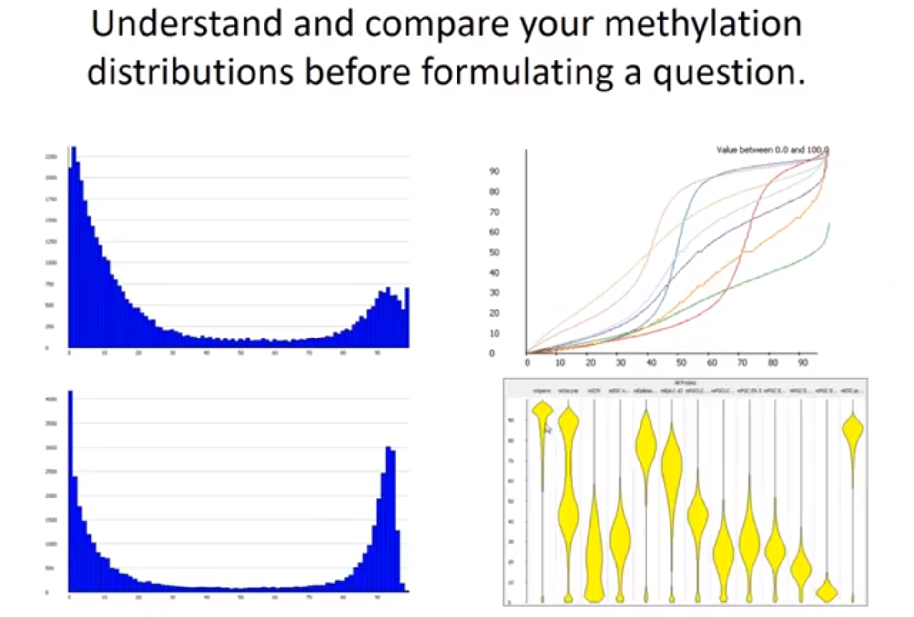
Look at this early on
y axis -methylation% against the percentile
through the data
The Dist. –
What is the dist.?
Does it change between sample?
Bean plots - 👍
Fundamental diff.s in the happening of methylation
a set of positions that do a staged change from low to high – never in between

Slide 25
Possible problems
Globally obvs. Problems should be apparent
How should we search for these -
Firstly randomly browse the genome
Secondly you should look at anywhere where you think you know what should be happening
For example – Looking at a methylation sample; look through particular regions which we know are supposed to be differentially methylated
Why? - ∵ that should either match with your expectations or if it doesn't then you've got something you need to understand

Slide 26
PART 3 Post-visualization
Differential Methylation Analysis
Group discussion ***

Slide 27
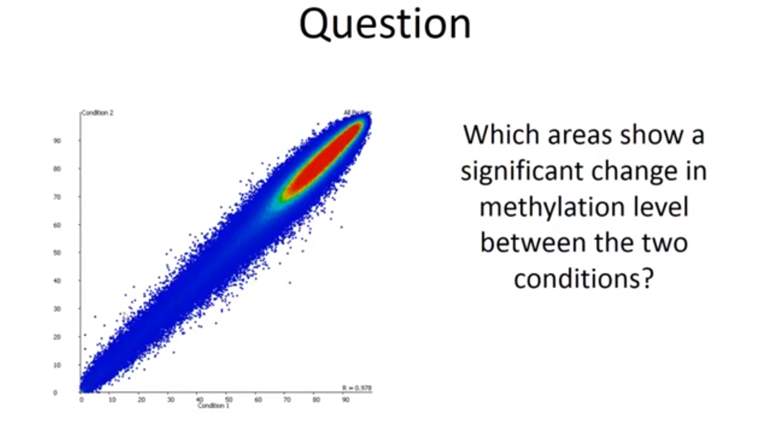
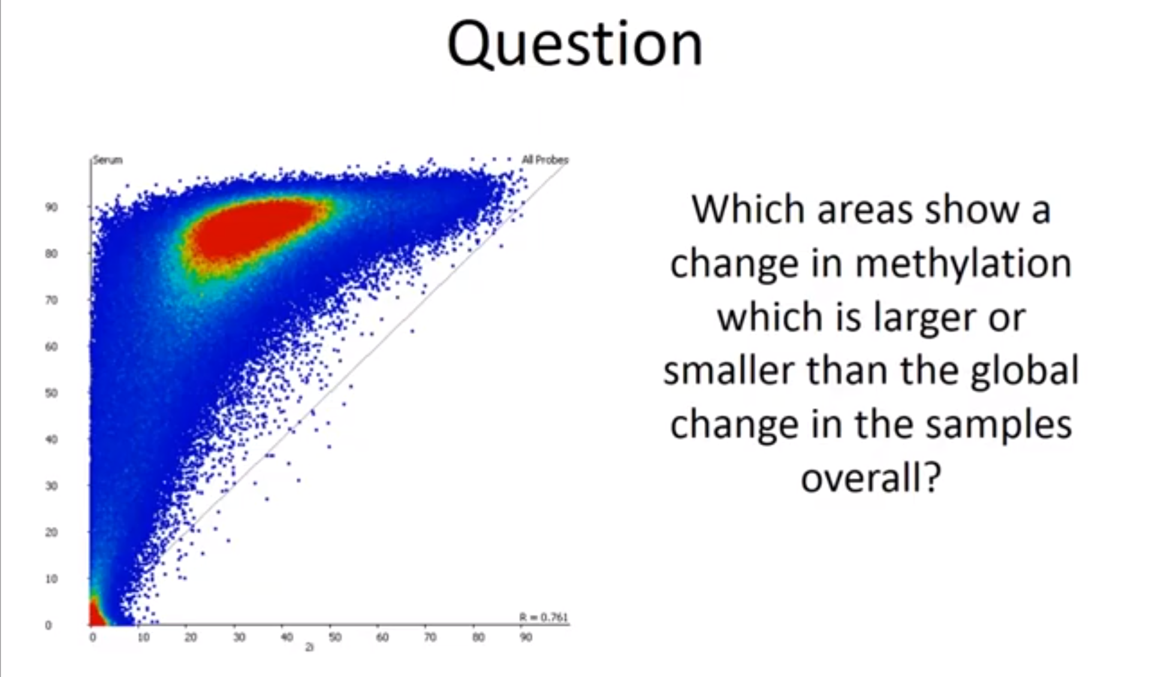
Differential Methylation Analysis
Sensible – little dev. from x=y
Interesting - Why didn’t it change as much?
Possible points of interest
Not-Sensible – everything is diff.
POI – Variation form general trend

Slide 28
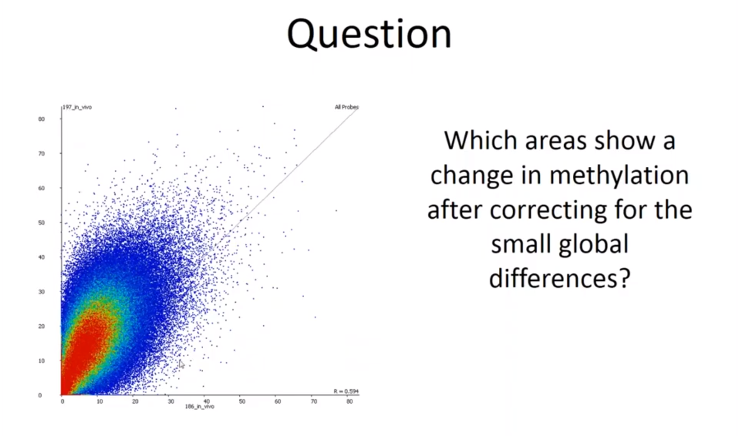
Differential Methylation Analysis
Notice: Global shift.
Sensible approach – 1st Account for shift – Method?
2nd Search for unusually changing point
Hybrid Methylation Comparison

Slide 29
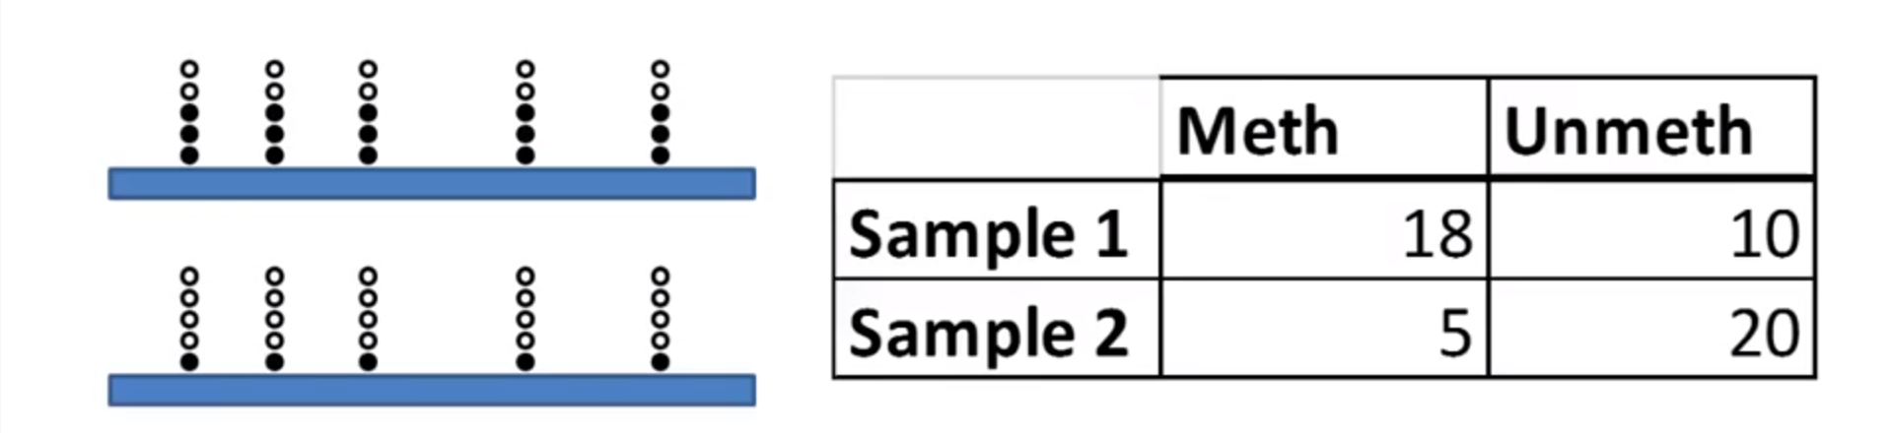
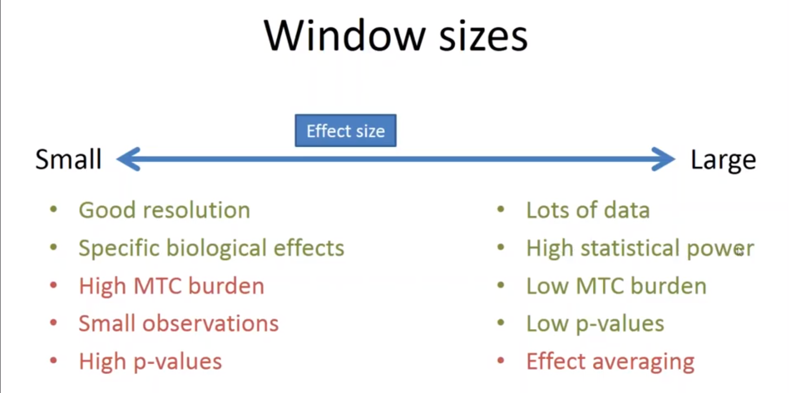
Count-Based Statistics (Pair-wise Comparison)
Statistically diff. – 1. No. of obsv.
2. Methyl ratio
↑ Stat power ⇒ ↑ Conf. in C-B Stats
Run into a problem
Can’t analyse every C in genome
Can’t analyse every C in genome
Use windows
Leads to… Trade off

Slide 30
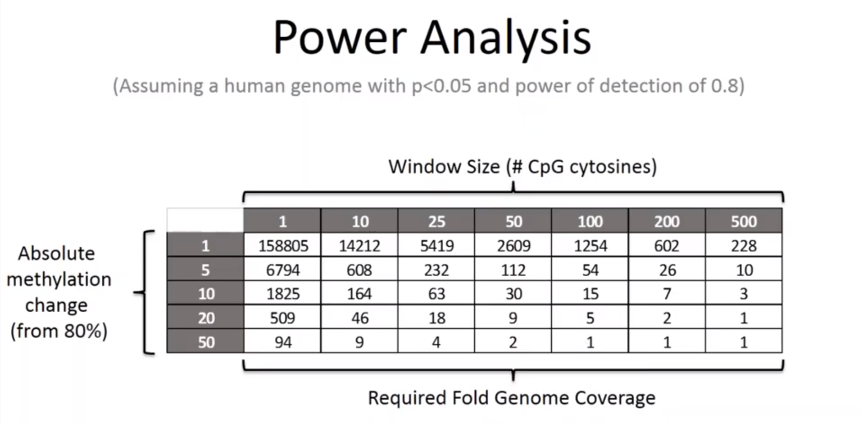
How do we define coverage ???

Slide 31
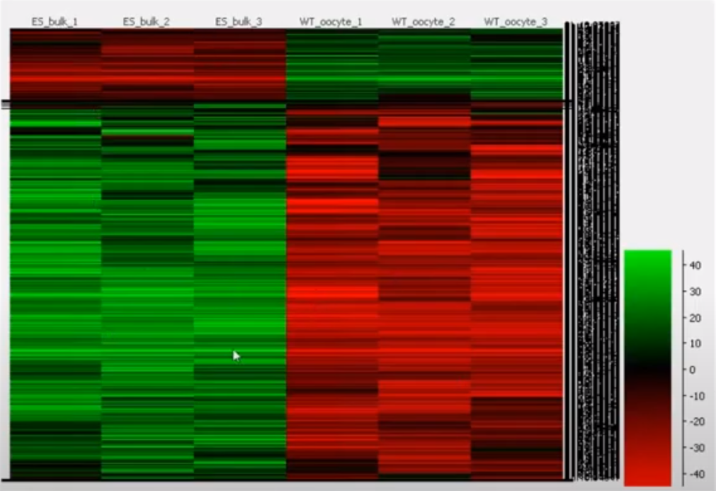
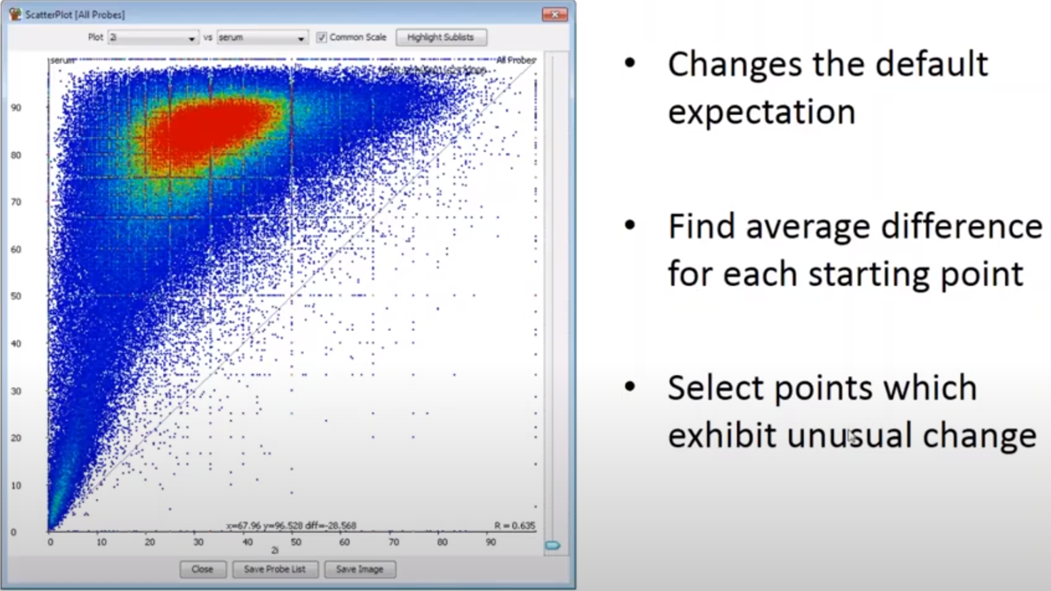
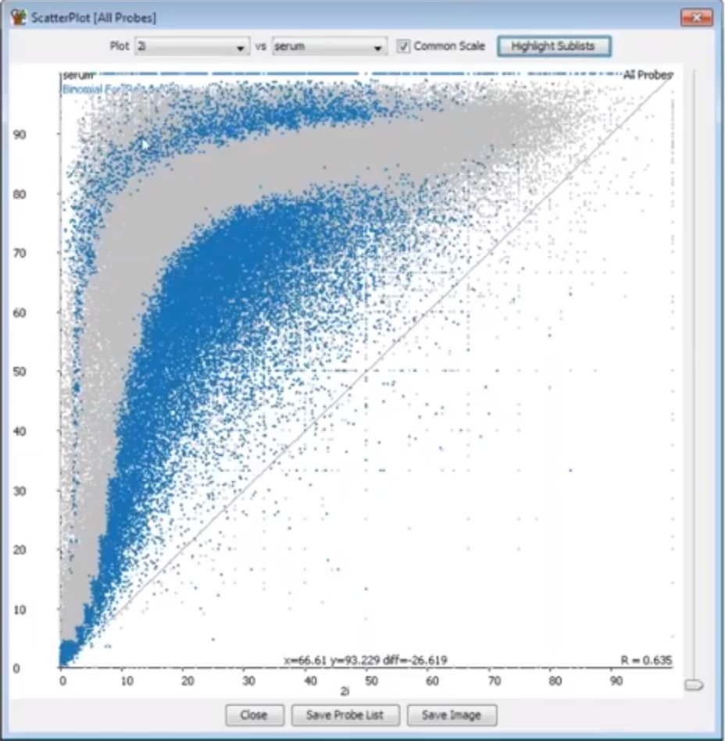
Applicable Statistics
Unreplicated – Limitation: single observation statistics
Chi-squred
Fisher exact
Replicated – Recommended
1. Logistic Regression (well behaved) 2. Globally shifted data
Lost more Or Retained more

Slide 32
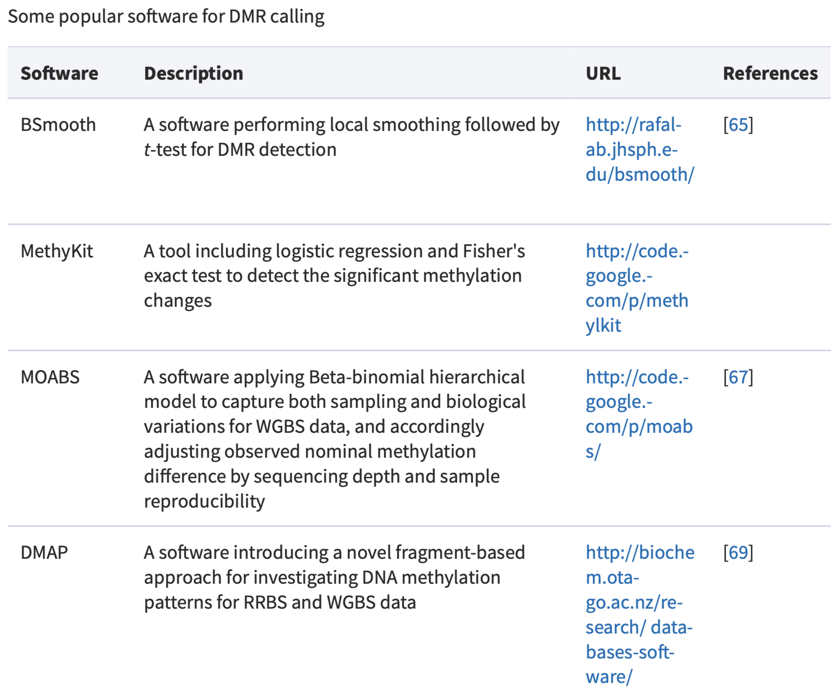
Differentially methylated regions (DMR) calling

Slide 33


Group study and individual cases
Group study:
similarity and differences among research groups
similar (un)methylated patterns and regions → functions
distinct ones → functions 😄 😄
Individual research
Combing current research and the cases
Exploring further functions and mechanism 😢 😢
Notes:
说说我的看法，理解，然后让老师们说一下它的想法，如何研究
我还需要倒回去再看看文献，别人怎么具体研究

Slide 34
GRAPE types and group study
Grafted and non grafted grapes
Pinot.n and Pinot.aus
Muscat family
Muscat d’Alexandrit and Muscat d’Eisenstadt
Pinot family
Pinot.n, Gamay and Chasselas
Others
Cabsua, Chardonnay, and Ripriari
Botanical prints online
Notes:
最后整理一下研究思路，然后发给robin和lei确认一下再开始研究

Slide 35
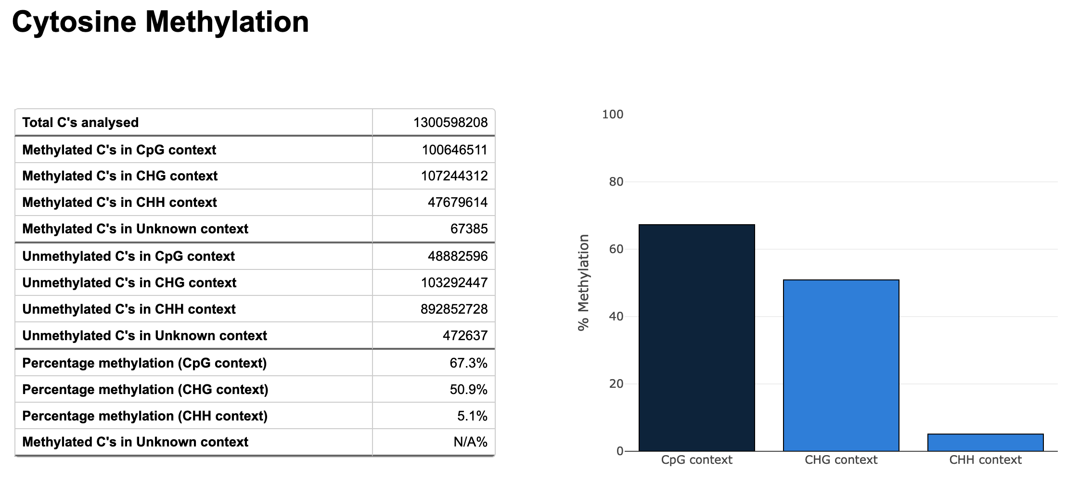
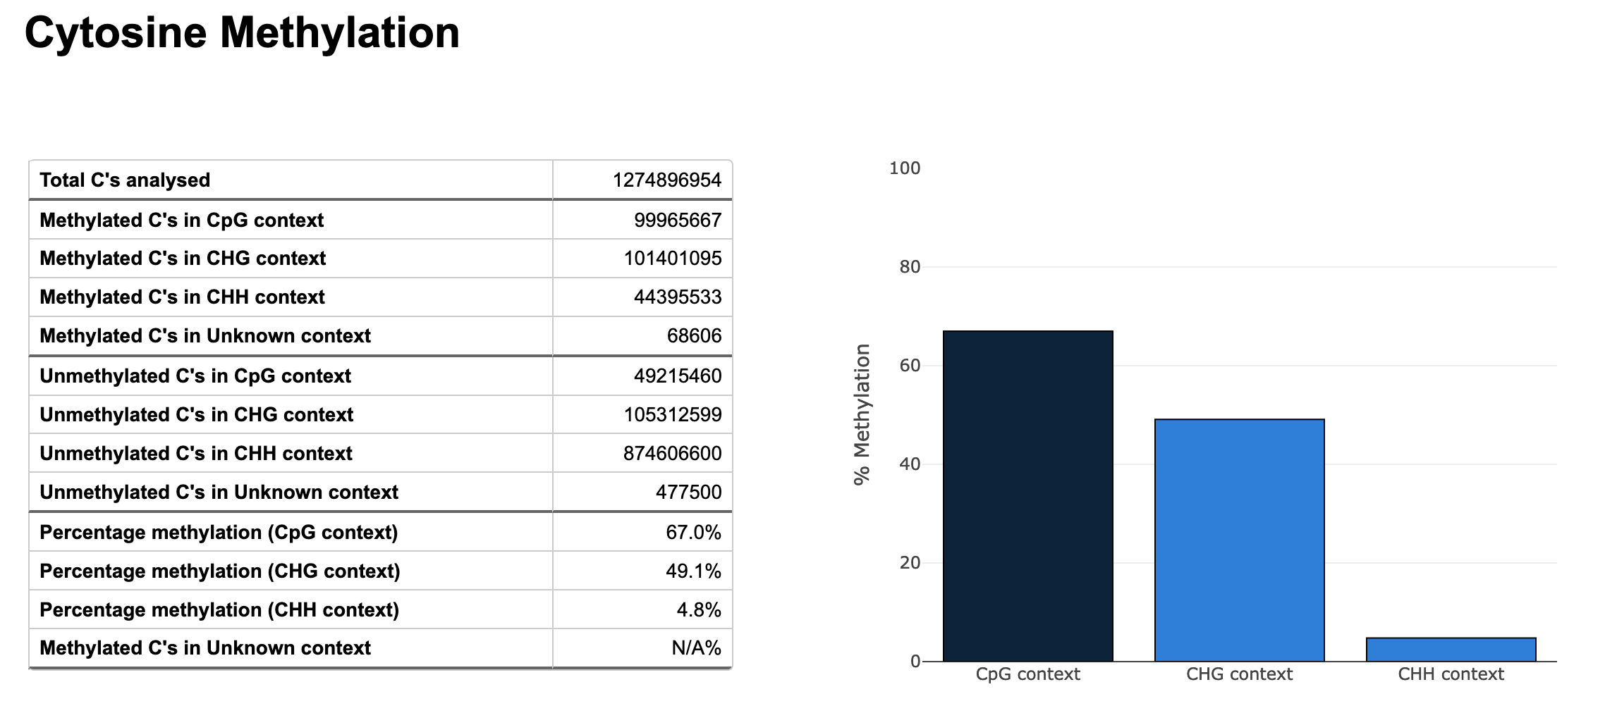
Muscat d’Alexandrit and Muscat d’Eisenstadt

Slide 36
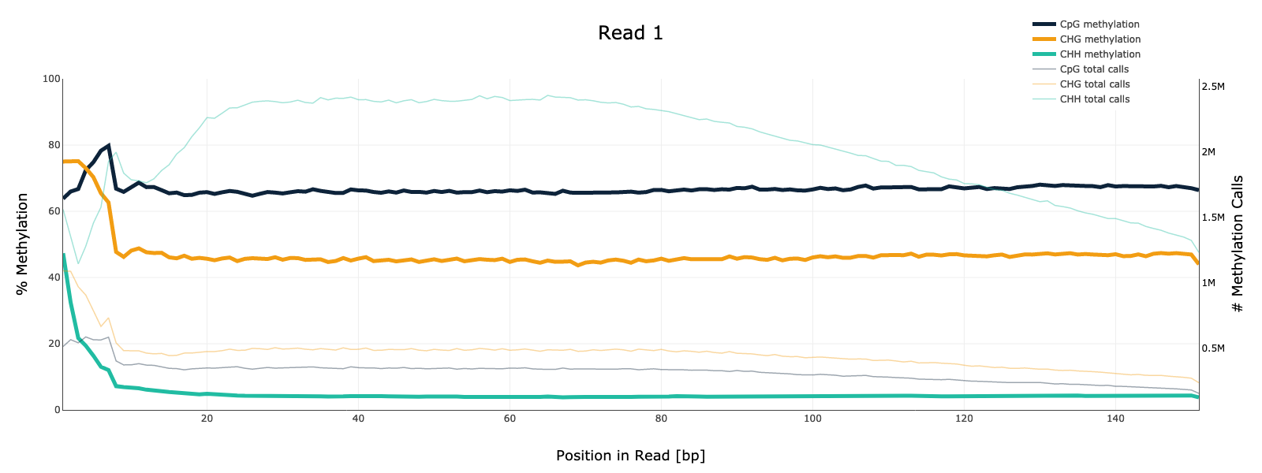
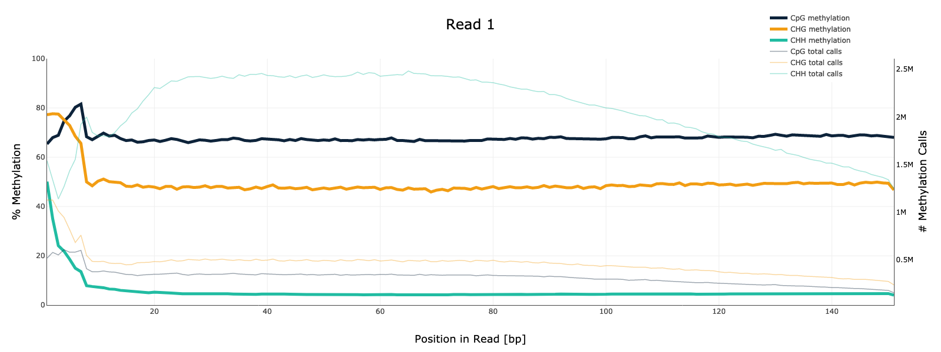
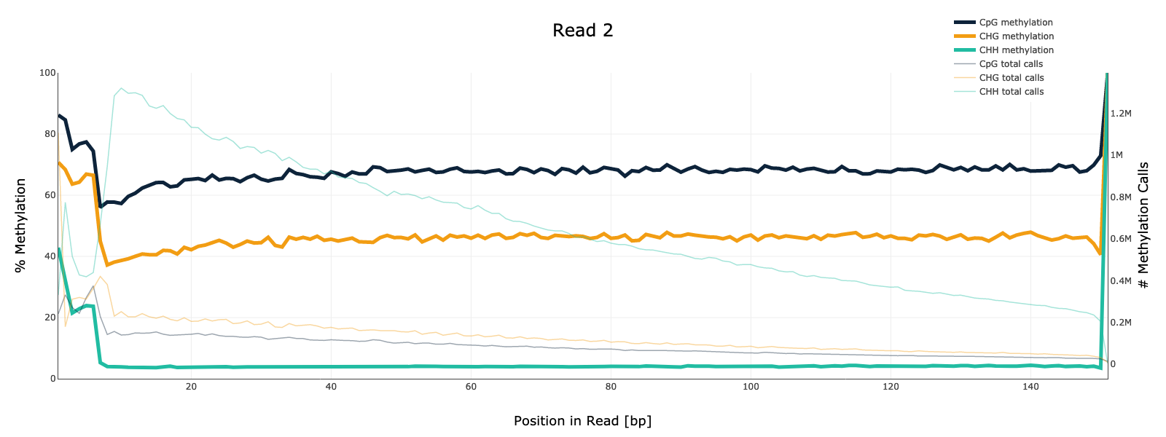
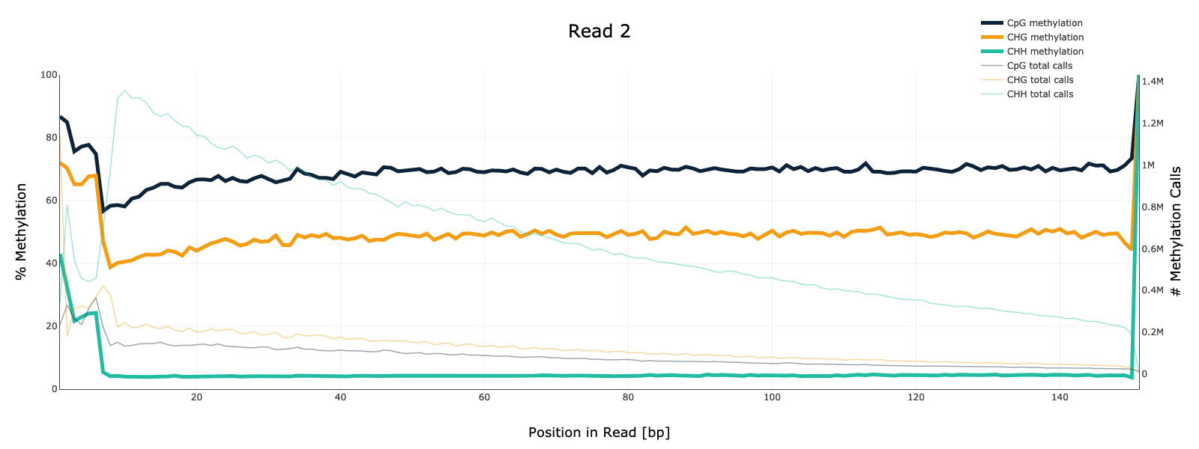
Muscat d’Alexandrit and Muscat d’Eisenstadt
Notes:
要删去开始的部分，让曲线的看起来更加平滑。

Slide 37
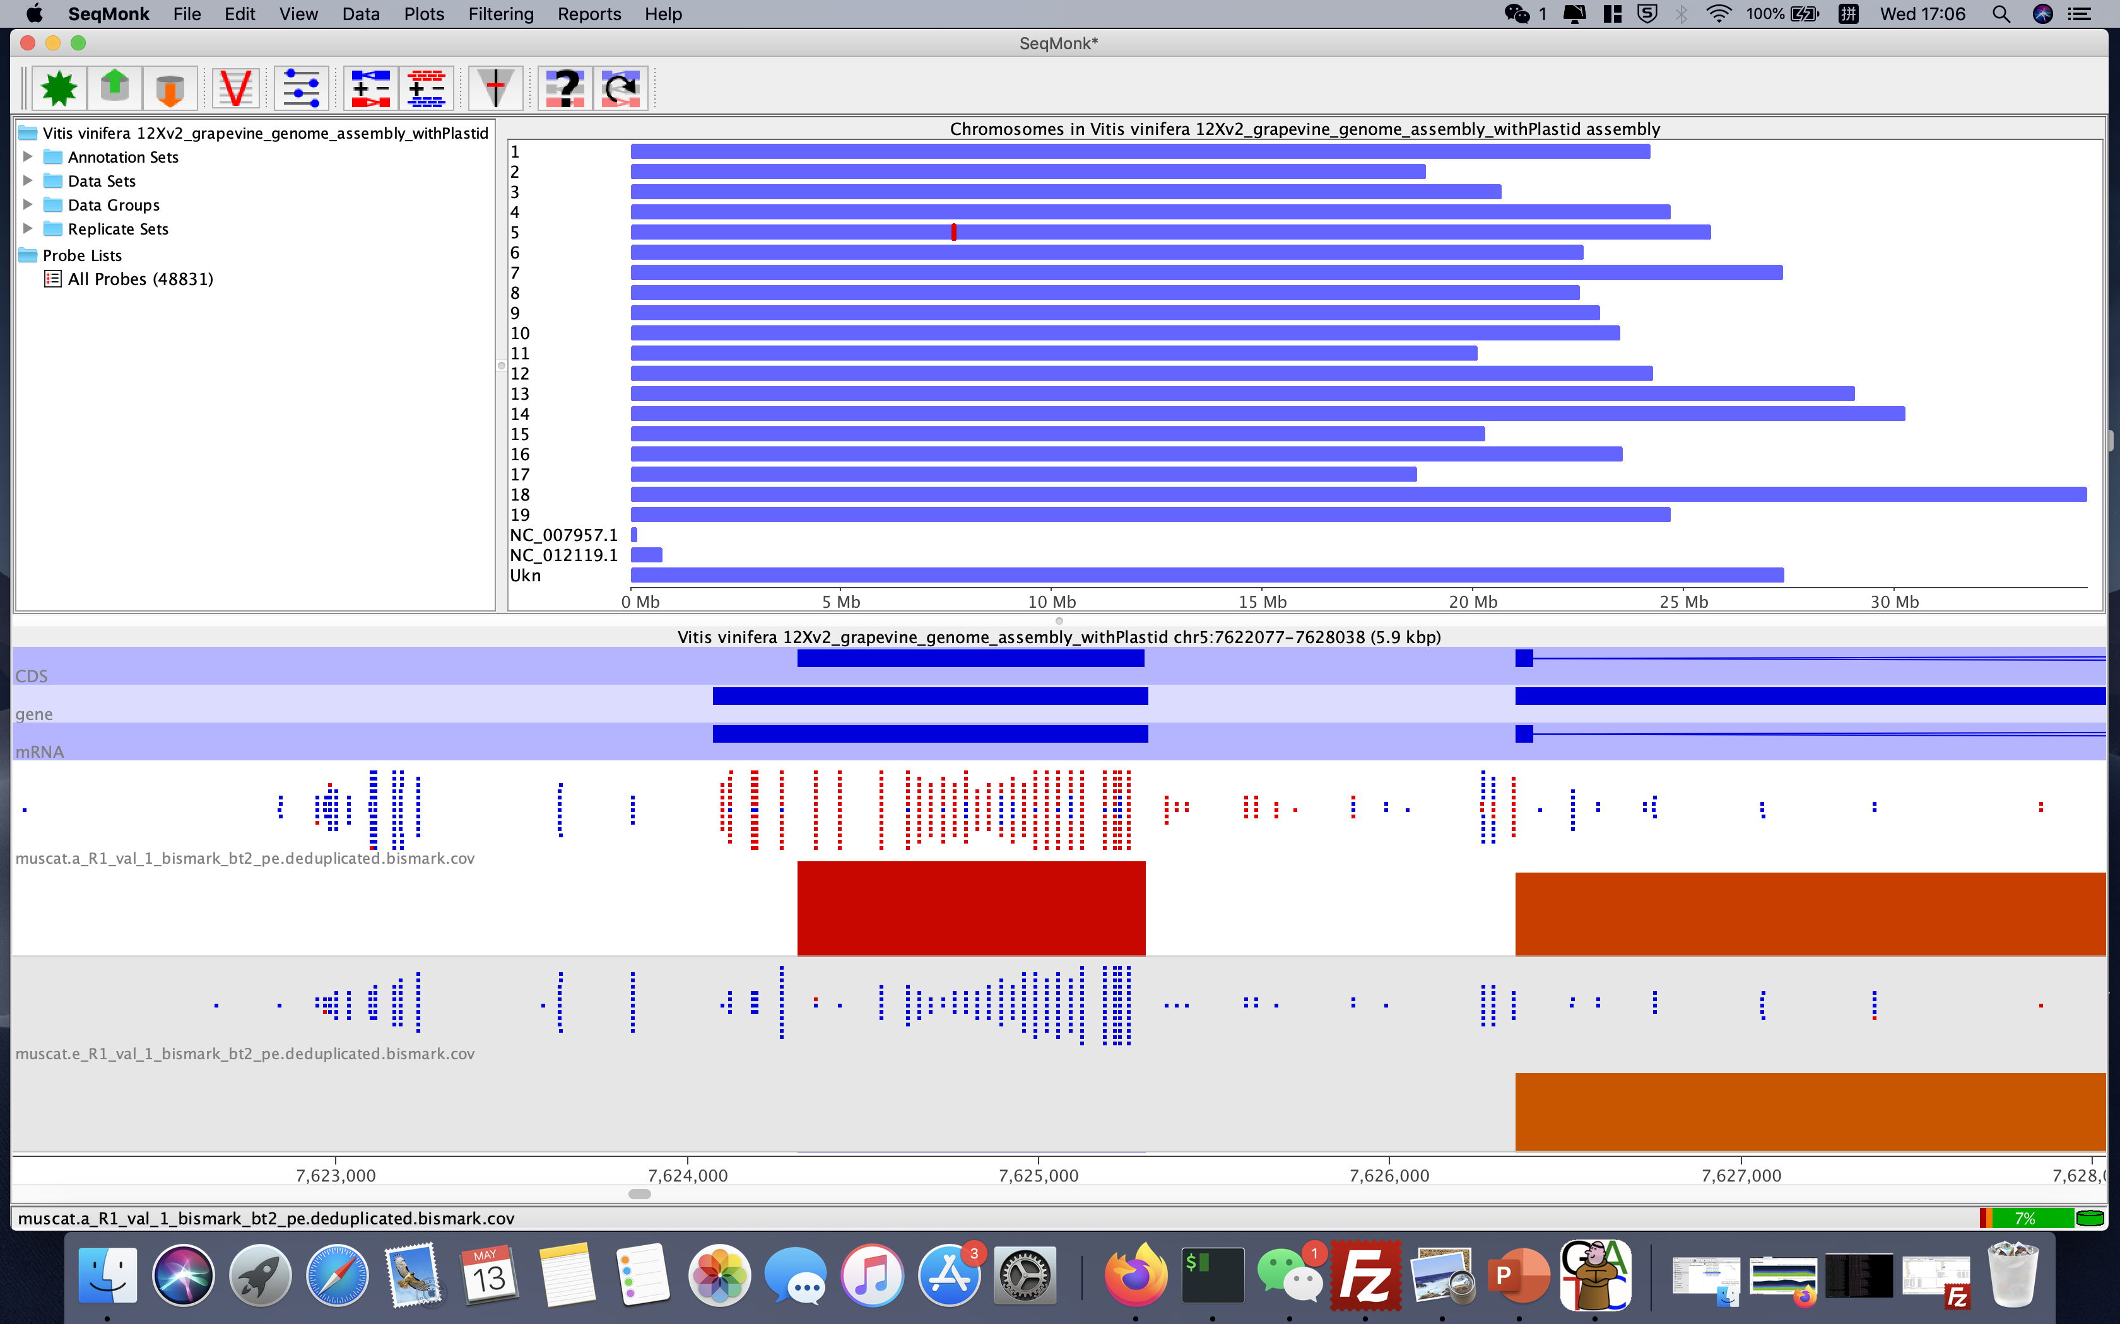
Muscat d’Alexandrit and Muscat d’Eisenstadt

Slide 38
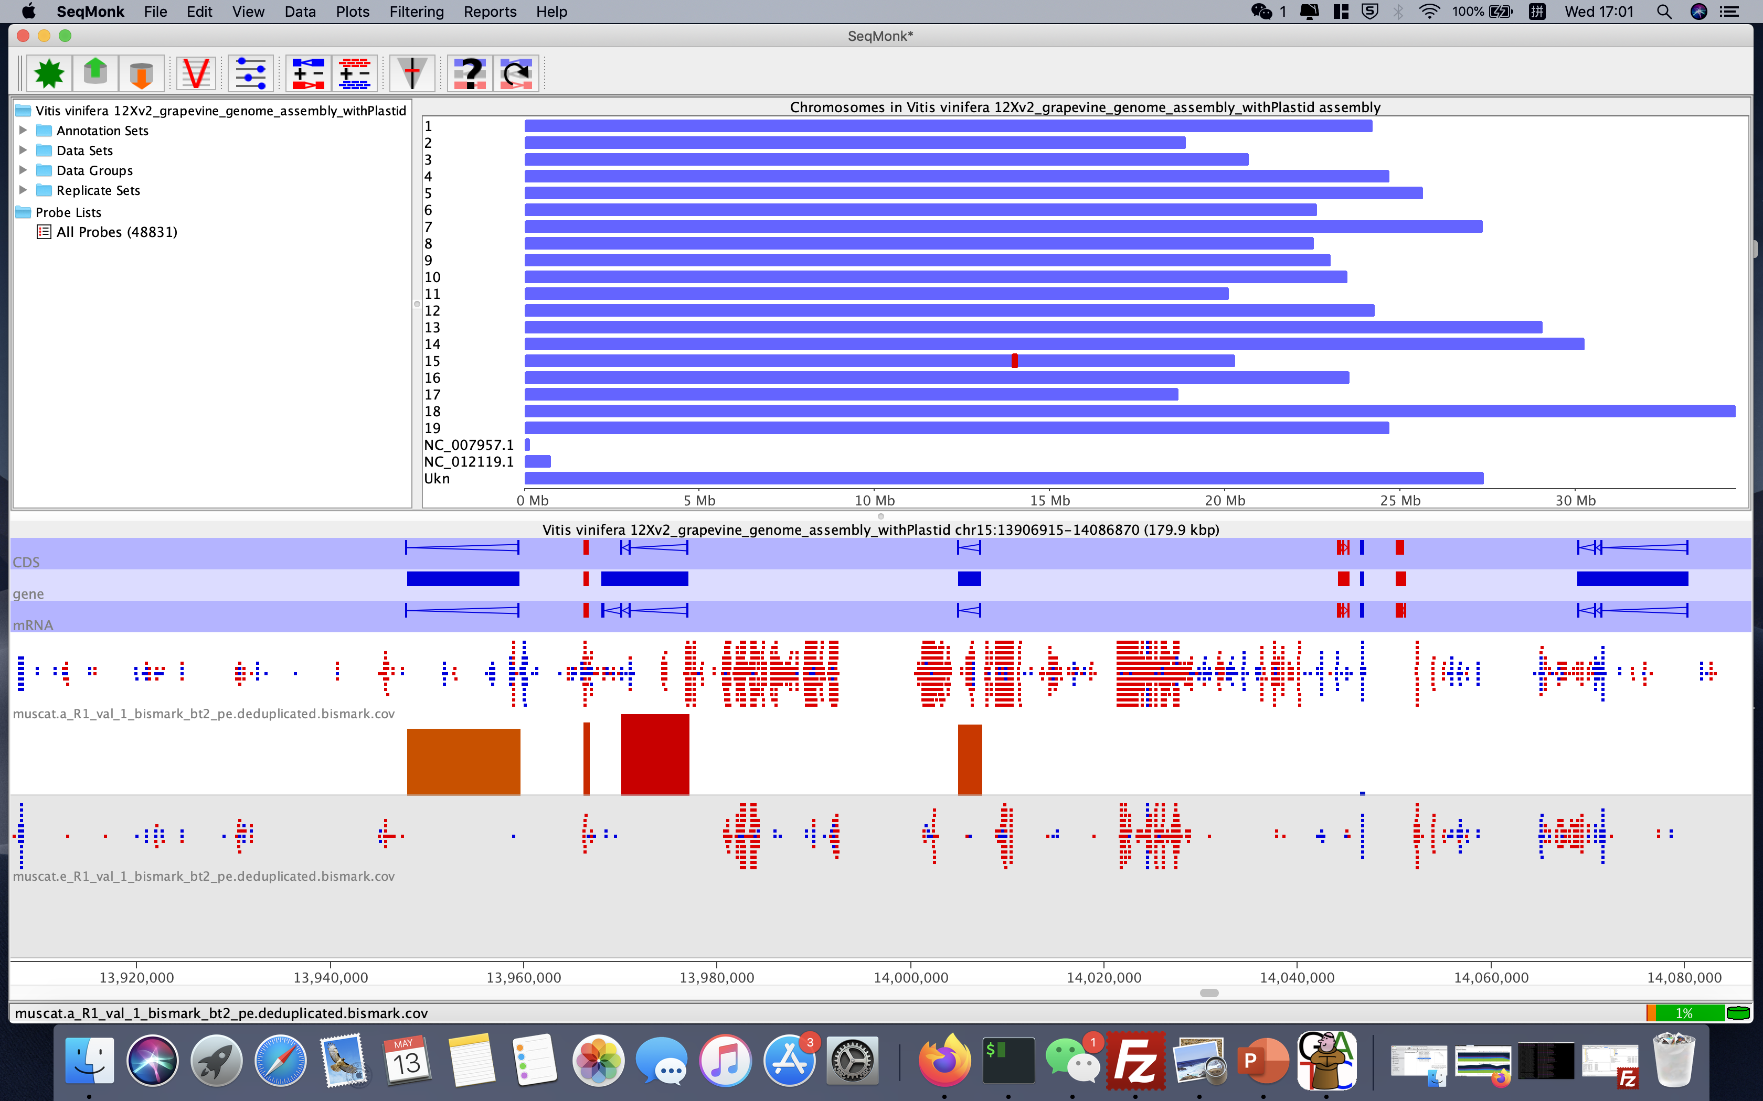
Muscat d’Alexandrit and Muscat d’Eisenstadt

Slide 39
Group Discussion
What is the scientific question in this project？
What is the research hypothesis？
What analysis methods should we use？
A project title
……

Slide 40

Acknowledgement
Thank Robin Allaby and Hsiao-Lei Liu for nice supervision.
Thank Aryan Gupta, Felix Krueger, Morrison Ryan for technical support.
13 05 20 / Shuya Zhang / Warwick

